Slide 1



Slide 2

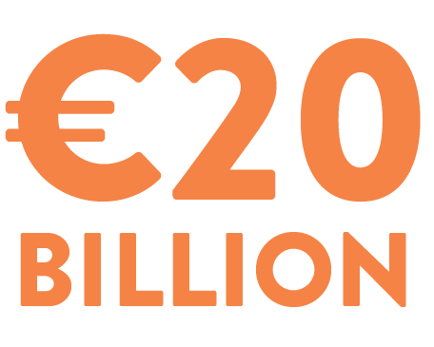

WHAT IS GPP?
Green Public Procurement is about the public sector choosing more sustainable products and services
In Ireland, public procurement is worth more than
€20 billion each year
From major infrastructure investments, through to small local deliveries, each contract has an environmental impact

Slide 3
IRELAND’S COMMITMENTS
Ireland has committed to reducing greenhouse gas emissions by
51% by 2030,
and reaching
net zero by 2050
Public bodies must deliver a
50% improvement in
energy-efficiency
by 2030
Under the Buying Greener Strategy and Circular 17/2025, all tenders valued above €50,000 (or €200,000 for works) must include
green criteria
Other targets apply in specific sectors, e.g. a minimum of 10% by value of food procured in public contracts to be certified organic under the Public Sector Climate Action Mandate
REFERENCE DOCUMENTS:
Climate Action and Low Carbon Development (Amendment) Act 2021 (setting out the 2030 and 2050 commitments)
Department of the Environment, Climate and Communications (2024) Buying Greener Strategy and Action Plan
Office of Government Procurement (2025) Circular 17/2025: Updated Green Public Procurement Instructions for Public Bodies
Government of Ireland, Public Sector Climate Action Mandate 2025 (Appendix 1 of 2025 Climate Action Plan)

Slide 4

EU LAW & POLICY
EU public procurement rules allow environmental considerations to be included at each stage of a tender
For some purchases, public bodies must apply minimum environmental criteria, e.g. energy-using products, batteries, buildings and vehicles
EU GPP criteria based on life-cycle assessment studies have been adopted for 20 product/service categories
There is increasing focus on circular economy considerations, e.g. in the Ecodesign regulations
Further information on EU law and policy relating to Green Public Procurement is available at: https://green-forum.ec.europa.eu/green-business/green-public-procurement_en

Slide 5



ABOUT GPP
GPP is about specific actions which suppliers and service providers take in delivering public contracts
GPP criteria are designed to be fair to all bidders – and require proof of the green claims made
GPP isn’t about green marketing or general corporate commitments

Slide 6




EXAMPLE: GPP IN ACTION
Bus Éireann implemented GPP in a tender for vehicle cleaning and auxiliary cleaning services, across locations throughout the country
Market consultation held in advance of the tender to ensure sustainable services were available
EPA GPP Guidance and Irish GPP Criteria for Indoor Cleaning Services were used to set criteria relating to staff training, sustainable products/equipment and waste segregation
15% of the marks at award stage available for these measures
Smart dose technology and compact high dilution products has resulted in reduced use of chemicals, plastic and cardboard which has saved approx. 3580 kg of GHG emissions
Full case study available here

Slide 7
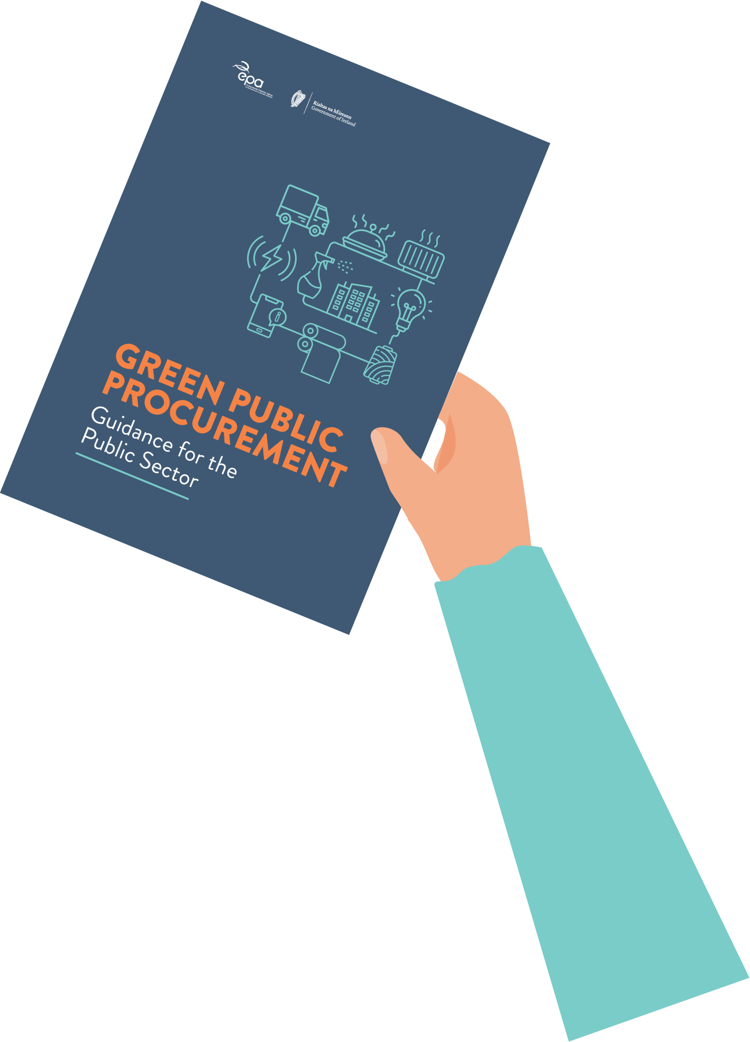
EPA GUIDANCE ON GPP
Updated in 2024 to reflect legislation and best practice for GPP
Explains concepts such as market engagement, needs assessment, GPP criteria and life-cycle costing
Includes advice on implementing, monitoring and reporting on GPP
Gives an overview of environmental impacts for 13 product/service sectors and relevant legislation, standards and certifications
Links to further resources and helpful tools
The EPA guidance on GPP (third edition) was published in July 2024 and can be accessed at: https://www.epa.ie/publications/circular-economy/resources/epa-gpp-guidance-for-the-public-sector-2024.php

Slide 8


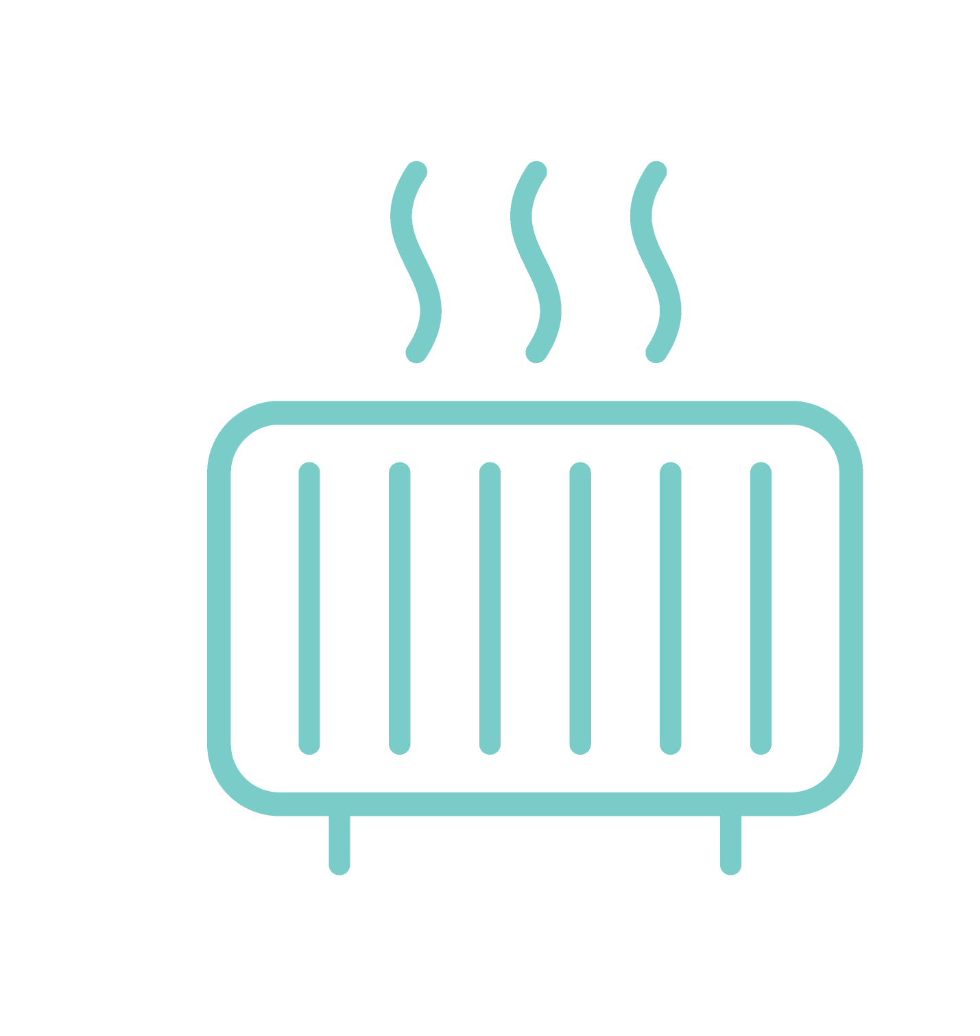








IRISH GPP CRITERIA
Energy-related products | Food and catering services
Heating equipment | ICT products and services
Indoor cleaning services | Indoor and outdoor lighting
Design, construction and management of office buildings | Paper products and printing services
Textile products and services | Road transport vehicles and services
Furniture and related services

Slide 9


IRISH GPP CRITERIA
Detailed criteria covering 11 priority product and service groups
Based on EU GPP criteria, with some adjustments to reflect the Irish market
WHAT DO THE CRITERIA INCLUDE?
Specifications, selection and award criteria and contract performance conditions
Relevant standards, legislation, certifications and ecolabels
Verification clauses – stating the evidence bidders need to provide

Slide 10
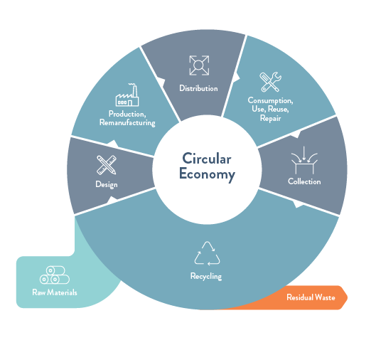
GPP & THE CIRCULAR ECONOMY
Circular economy is about moving away from the ‘take-make-use-waste’ model by maintaining the value of resources
GPP criteria address the entire life-cycle, e.g. raw materials, manufacturing and processing, use phase and end-of-life
EXAMPLES:
The ICT criteria include requirements for rechargeable battery performance, repairability and design for disassembly
The food and catering services criteria include requirements for organic and sustainable production, packaging and redistribution of excess food
EPA Circular Economy Programme: https://www.epa.ie/environment-and-you/circular-economy/
Source: EPA Circular Economy Programme

Slide 11




WHAT YOU SHOULD EXPECT IN TENDERS
Exclusion grounds will include breaches of applicable environmental law
Selection criteria may ask for evidence of environmental management systems, supply chain management systems, previous experience, technical capacity and staff training/qualifications
Technical specifications will set minimum environmental requirements
Award criteria may target enhanced environmental performance
Contract performance clauses will enforce the environmental aspects and set requirements for monitoring and reporting

Slide 12

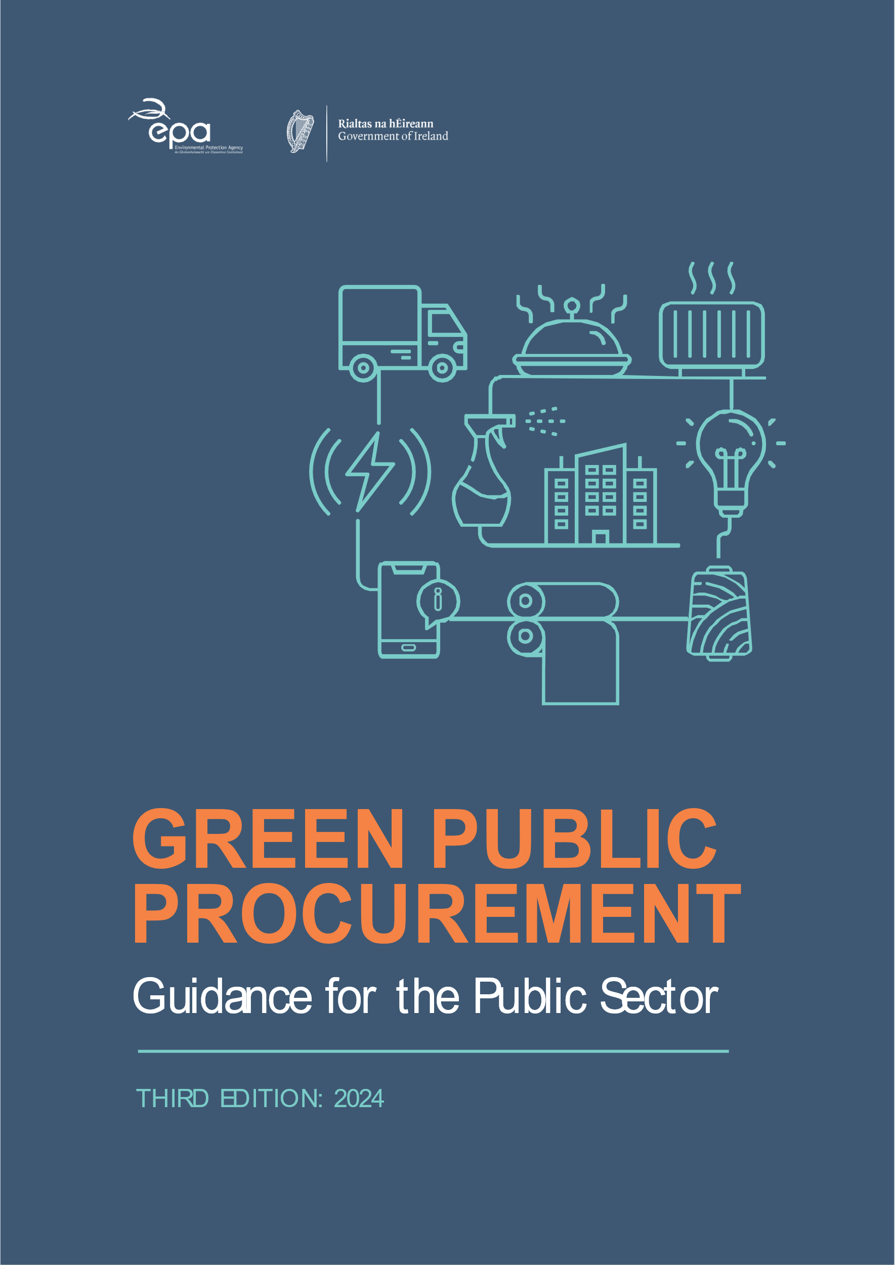
HOW TO PREPARE
Ask your public sector clients about how they are implementing GPP
Keep up to date with developments at EU level, including new editions of the GPP criteria and changes to legislation
Consider how you will demonstrate compliance with GPP criteria in the sector(s) in which you operate
Invest in relevant training and independent certification to demonstrate your firm’s green credentials
Measure the environmental impacts of your activities and set targets to reduce them
There are many freely available resources for measuring organisational/product environmental footprint:
Greenhouse Gas Protocol: ghgprotocol.org/
Carbon Disclosure Project: www.cdp.net/en
Product Environmental Footprint: https://green-forum.ec.europa.eu/green-business/environmental-footprint-methods_en
Global Reporting Initiative: www.globalreporting.org/

Slide 13


LINKS & RESOURCES
EPA page on Green Public Procurement: https://www.epa.ie/our-services/monitoring--assessment/circular-economy/green-public-procurement/
Gov.ie page on Sustainable Public Procurement: https://www.gov.ie/en/office-of-government-procurement/publications/sustainable-public-procurement/
EU GPP website:
https://green-forum.ec.europa.eu/green-business/green-public-procurement_en
Office of Government Procurement Circulars and Information Notes: www.gov.ie/en/organisation/office-of-government-procurement/

