Slide 1


Notes:
Food Vision is the latest 10 year strategy for the Irish agri-food sector.
It was created by a 32 member committee – representative of a broad cross section of the entire agri-food industry including primary producer representatives, semi state bodies including Food Safety Authority of Ireland, Teagasc, Bord Bia and the Environmental Protection Agency as well as representatives from finance and ag tech.
The Strategy aims for Ireland to be a World Leader in Sustainable Food Systems,
And is comprised of 4 missions, 22 goals and 218 actions.
It is the outcome of these Missions, Goals and Actions which we aim to capture and present as key environmental, economic and social indicators in the dashboard presented today.
If more information on the strategy is required then please visit the website or contact the Food Vision email address at foodvision@agriculture.gov.ie

Slide 2
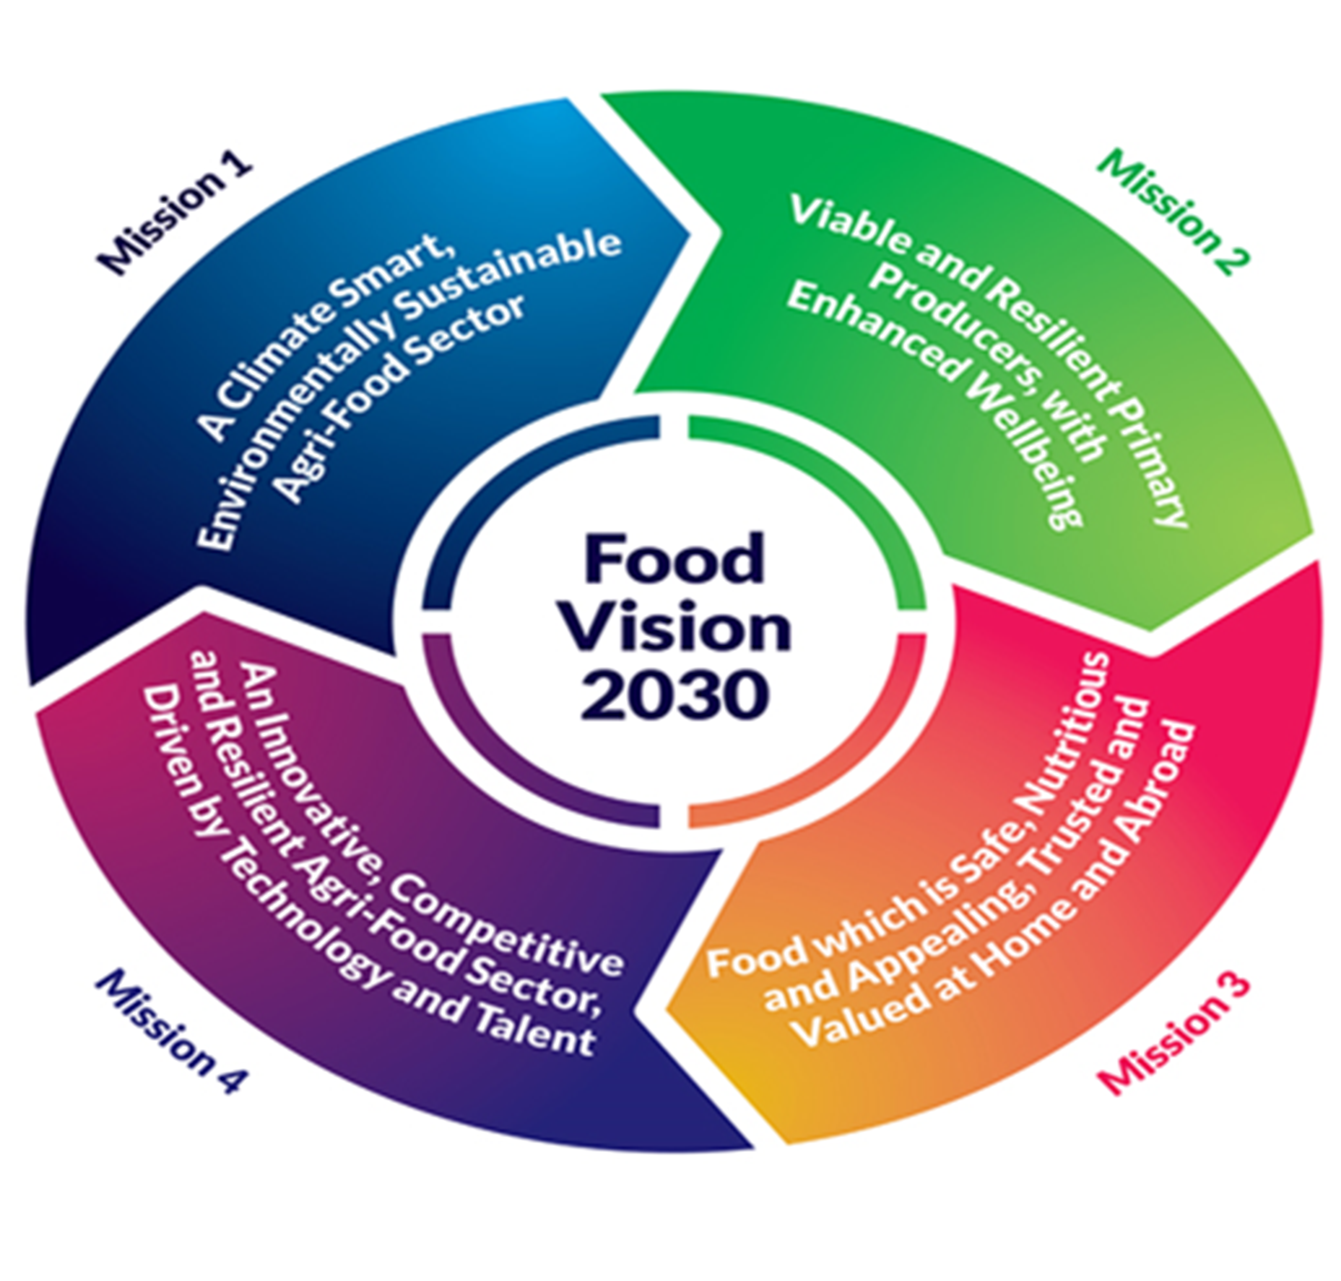
Background
Food Vision 2030 is the 10-year strategy for the Irish Agri-Food sector.
Created by a 32-member committee – representative of a broad cross section of the industry
Includes primary producer representatives and semi state bodies including
Food Safety Authority
Environmental Protection Agency
Bord Bia
The Strategy aims for Ireland to be a World Leader in Sustainable Food Systems
Comprised of 4 missions, 22 goals and 218 actions.
Aim to capture outcomes and present as the following indicators
Environmental indicators
Economic indicators
Social indicators.

Slide 3
Project Objectives
The Food Vision 2030 Dashboard will identify baseline data to monitor progress against agreed goals as defined by the Strategic Environmental Assessment (SEA) Indicators for the Food Vision 2030 Strategy.
The first phase of the dashboard is focused on Mission 1 key indicators .
These indicators were identified and mandated through a consulting process.
The next phase of the dashboard will focus on the economic and social key indicators identified in the strategy across Missions 2, 3 and 4
Dashboard will facilitate the data to be assembled centrally and automated over the course of the programme.
Deploy an internal dashboard available to DAFM.
Dashboard to also be made available to the public through gov.ie and DAFM websites
Make accessible through the public portal for the Food Vision Strategy charting Irelands journey towards being a World Leader in Sustainable Food Systems.

Slide 4
Approach
1
Mission 1
A Climate Smart, Environmentally Sustainable Agri-Food Sector
4
Missions
Key Indicators:
• Biogenic methane level
• Ammonia and Nitrous Oxide emissions
• Water quality
• Biodiversity – land and sea
• Afforestation level
• Level of organic farming
• Food Waste statistics
• Enhanced Origin Green Programme
Goals:
GOAL 1:
Develop a Climate Neutral Food System by 2050 and Improve Air Quality
GOAL 2:
Restore and Enhance Biodiversity
GOAL 3:
Protect High Status Sites and Contribute to Protection & Restoration of Good Water Quality and Healthy Aquatic Ecosystems
GOAL 4:
Develop Diverse, Multi-functional Forests
GOAL 5:
Enhance the Environmental Sustainability of the Seafood Sector
GOAL 6:
Embed the Agri-Food Sector in the Circular, Regenerative Bioeconomy
GOAL 7:
Strengthen Origin Green & Sustainable Supports to Reflect the Higher Level of Ambition
21
Key Indicators
80+
Metrics
100+
Datasets
30+
Dashboards

Slide 5
Approach
2
Mission 2
Viable and Resilient Primary Producers With Enhanced Well-being
4
Missions
Goals:
GOAL 1:
Improve the Competitiveness and Productivity of Primary Producers
GOAL 2:
Improve the Creation and Equitable Distribution of Value
GOAL 3:
Increase Primary Producer System Diversification
GOAL 4:
Improve the Social Sustainability of Primary Producers
21
Key Indicators
80+
Metrics
100+
Datasets
30+
Dashboards

Slide 6
Approach
3
Mission 3
Food which is Safe, Nutritious and Appealing, Trusted and Valued at Home and Abroad
4
Missions
Goals:
GOAL 1:
Prioritise Coherent Food and Health Policies to Deliver Improved Health Outcomes
GOAL 2:
Enhance Consumer Trust in our Food System, Providing Evidence of a Safe, Ethical Food Supply
GOAL 3:
Create Value-Add in Food Through Insight, Innovation and Product Differentiation
GOAL 4:
Develop Market Opportunities at Home and Abroad
21
Key Indicators
80+
Metrics
100+
Datasets
30+
Dashboards

Slide 7
Approach
4
Mission 4
An Innovative, Competitive and Resilient Agri-Food Sector, driven by Technology and Talent
4
Missions
Goals:
GOAL 1:
Move to a Challenge-Focused Innovation System
GOAL 2:
A Strategic Funding Approach for Research, Development and Innovation
GOAL 3:
Develop a Dynamic Knowledge Exchange Environment
GOAL 4:
Enhance the Use of Technology and Data
GOAL 5:
Maintain and Improve Competitiveness and Resilience
GOAL 6:
Attract and Nurture Diverse and Inclusive Talent
GOAL 7:
Policy Coherence in Sustainable Food Systems Between Ireland’s Domestic Policy and its Development Cooperation and Foreign Policy
21
Key Indicators
80+
Metrics
100+
Datasets
30+
Dashboards

Slide 8
Key Stakeholders
Data Management & Analytics Division - DAFM
Partner Agencies
Environmental Protection Agency
Bord Bia
The Irish Cattle Breeding Federation Marine Institute
National Parks & Wildlife Services University College Dublin
National University of Ireland Maynooth
An Bord Iascaigh Mhara
Agriculture and Food Development Authority (Teagasc)
Sustainable Energy Authority of Ireland
Business Owners
- DAFM
Others
DAFM customers
Public
Business Divisions
- DAFM
Poultry Division
Research & Codex
Direct Payments
Forestry Division
Economics and Planning

Slide 9
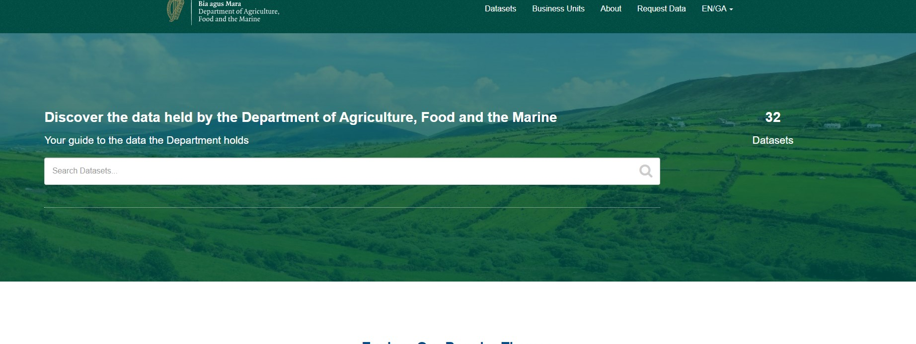
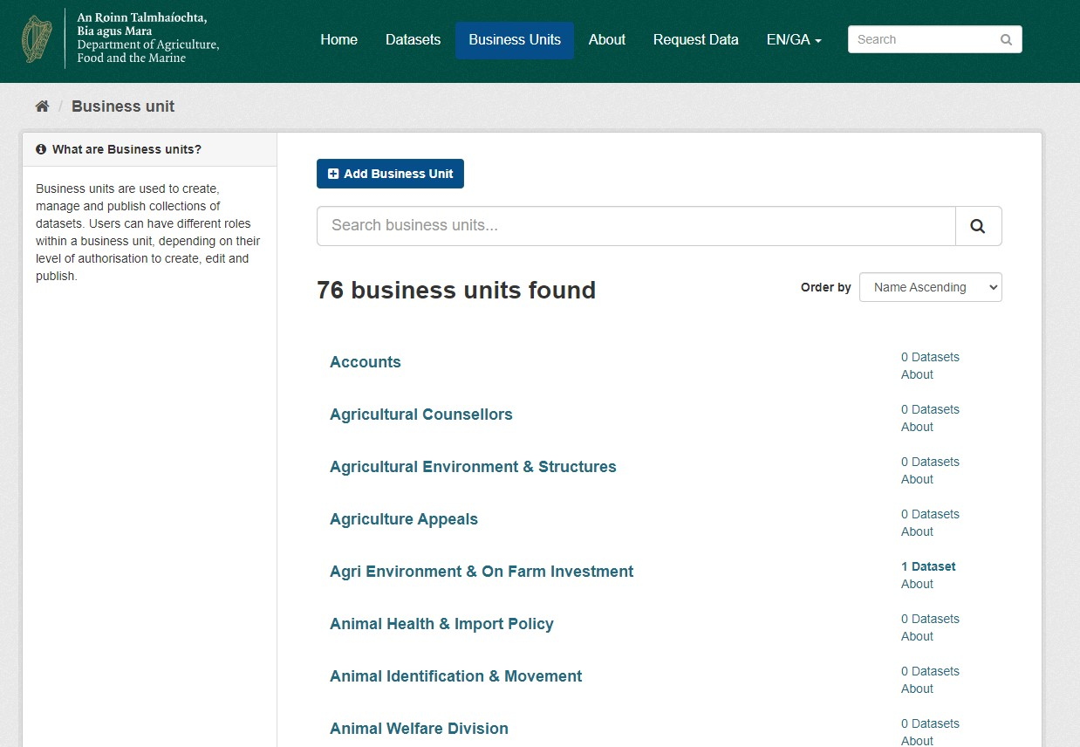
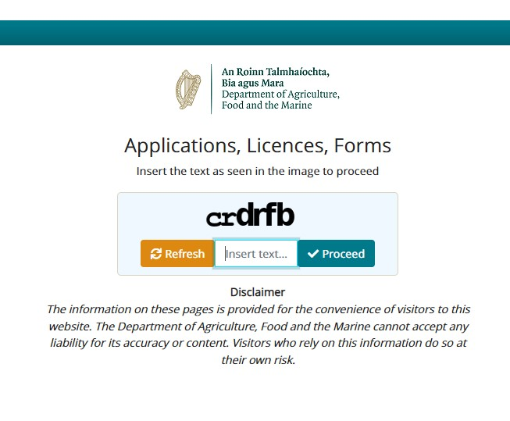
Data Sources - Open Data Portal
Thematic Areas
Animal Health & Welfare
Corporate
Sustainable Seafood
CAP
Forestry
Agri Food Trade
Climate
Land Use
Safe Food
DAFM Open Data (agriculture.gov.ie)
Notes:
9 Thematic data categories agreed with corporate affairs.
Each of the images have links to the relevant pages so be careful when clicking on them.

Slide 10
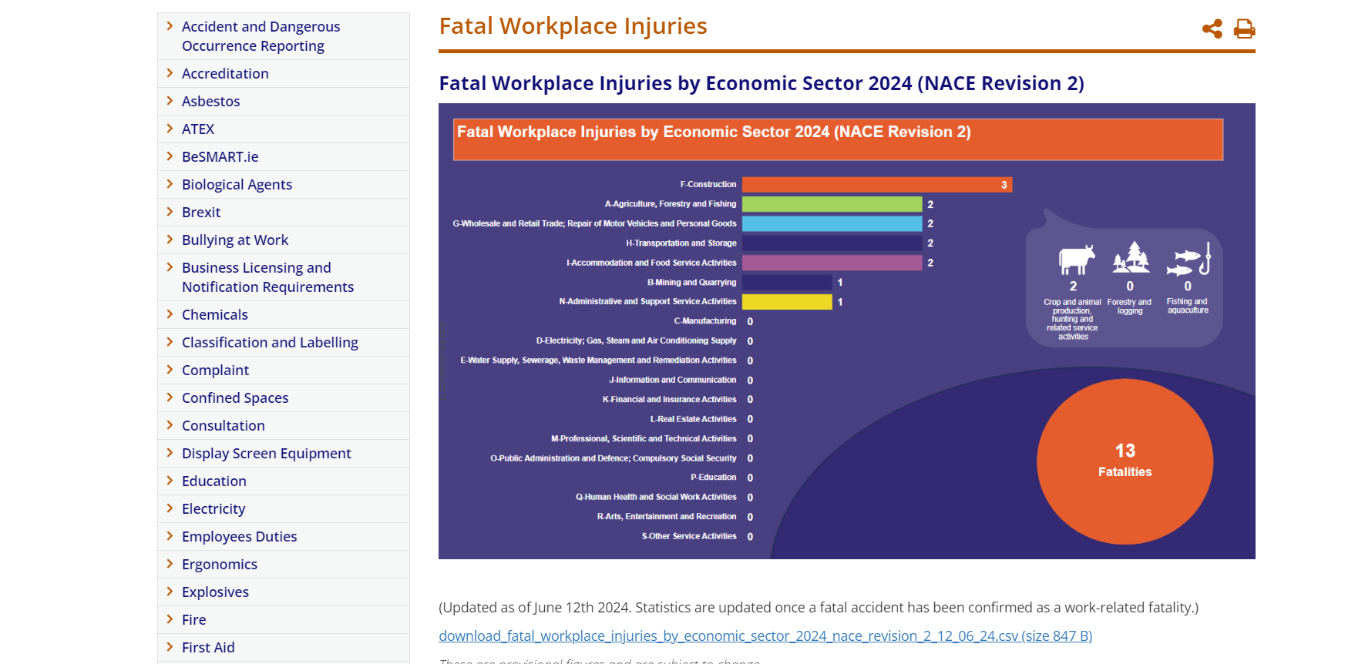

Slide 11
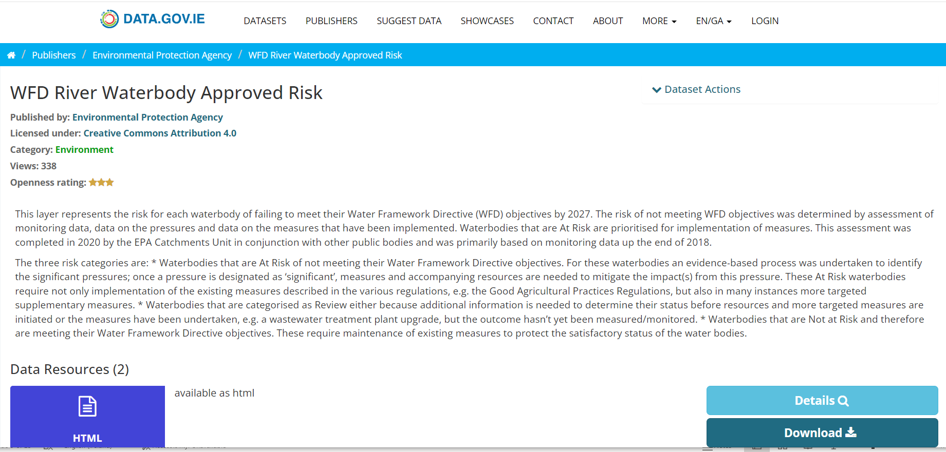

Slide 12
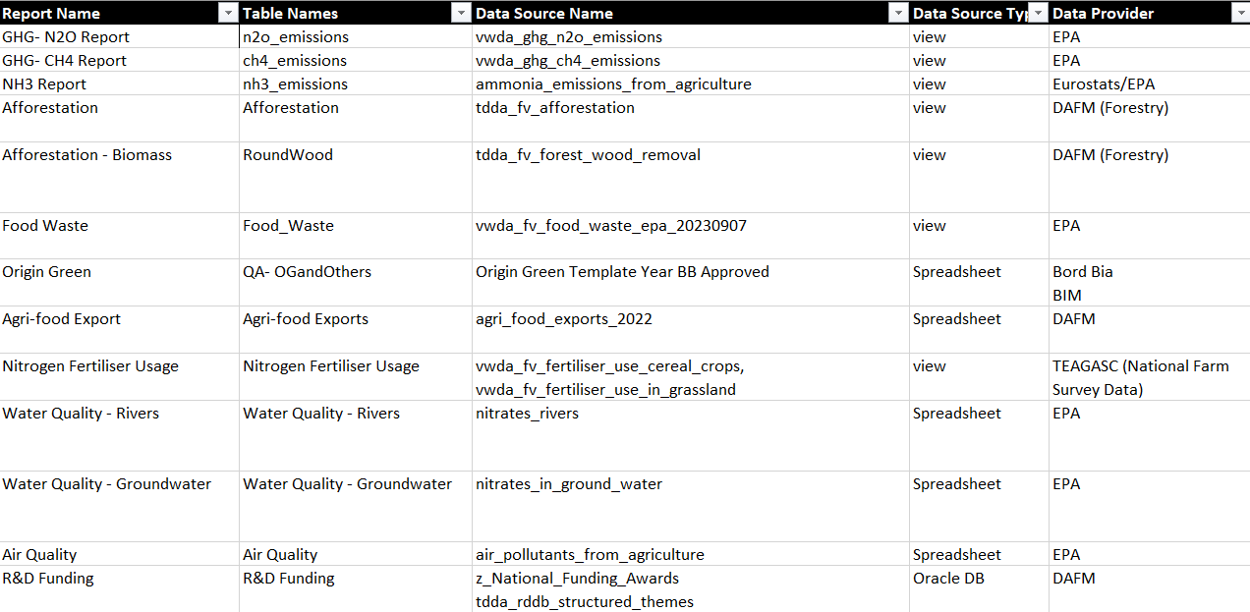

Slide 13







Methodology
Contents
Data Sources
Central Repository
Data Integration
Spreadsheets
eDocs Folders
Logical Data Warehouse
Power BI
Flat Files
Oracle Database
Data Migration
ETL
PDF Extracts
EPA, Board Bia, BIM, etc.
DAFM Environment for Staging
Data cleaning, processing, storage and transformation for reporting views
Business Intelligence reporting and deployment
Notes:
Data sources are open data, so data is in the public domain already. Establish a baseline

Slide 14
Pipelines Deployment
Workspaces
Three workspaces created in Power BI Service, Fabric platform
Development
Development phase where the developer built the Reports & dashboards in Power BI Desktop platform
Performing data modelling, creating DAX measure, visuals, etc.
Limited user access
UAT
Testing the Power BI reports on Power BI Service Platform
Performed Functional Testing
Performed Data Source testing
Performed UAT ( with the business users)
Limited user access
Production
Published the dashboard on Power BI Service platform
Embedding the reports on DAFM website
Embedding the reports on Food Vision portal
Public access to the reports
Adminstration

Slide 15
Development Timeline
February 2023
Onboarding and Discovery
March 2023
August 2023
POC Phase
PHASE II DASHBOARDS
December 2023
User Acceptance Testing
May 2023
PHASE I DASHBOARDS
March 2024
Updates based on feedback
July 2024
Handover: documentation & training
September 2024
Review of Website wording and links
August / September 2024
Feedback from Internal and External Stakeholders
October 2024
Go Live Dashboard Release

Slide 16


Slide 17
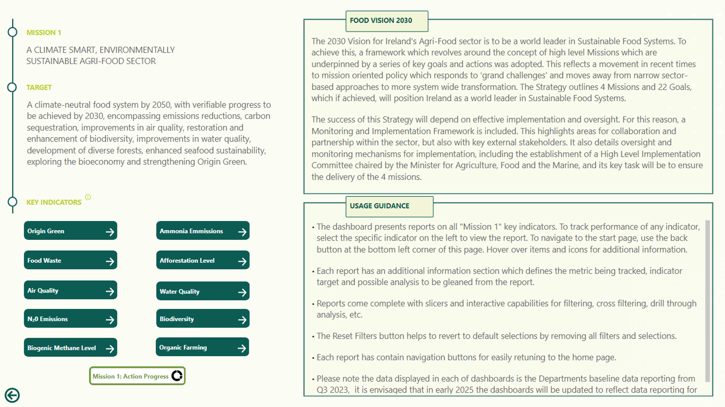
Mission 1

Slide 18
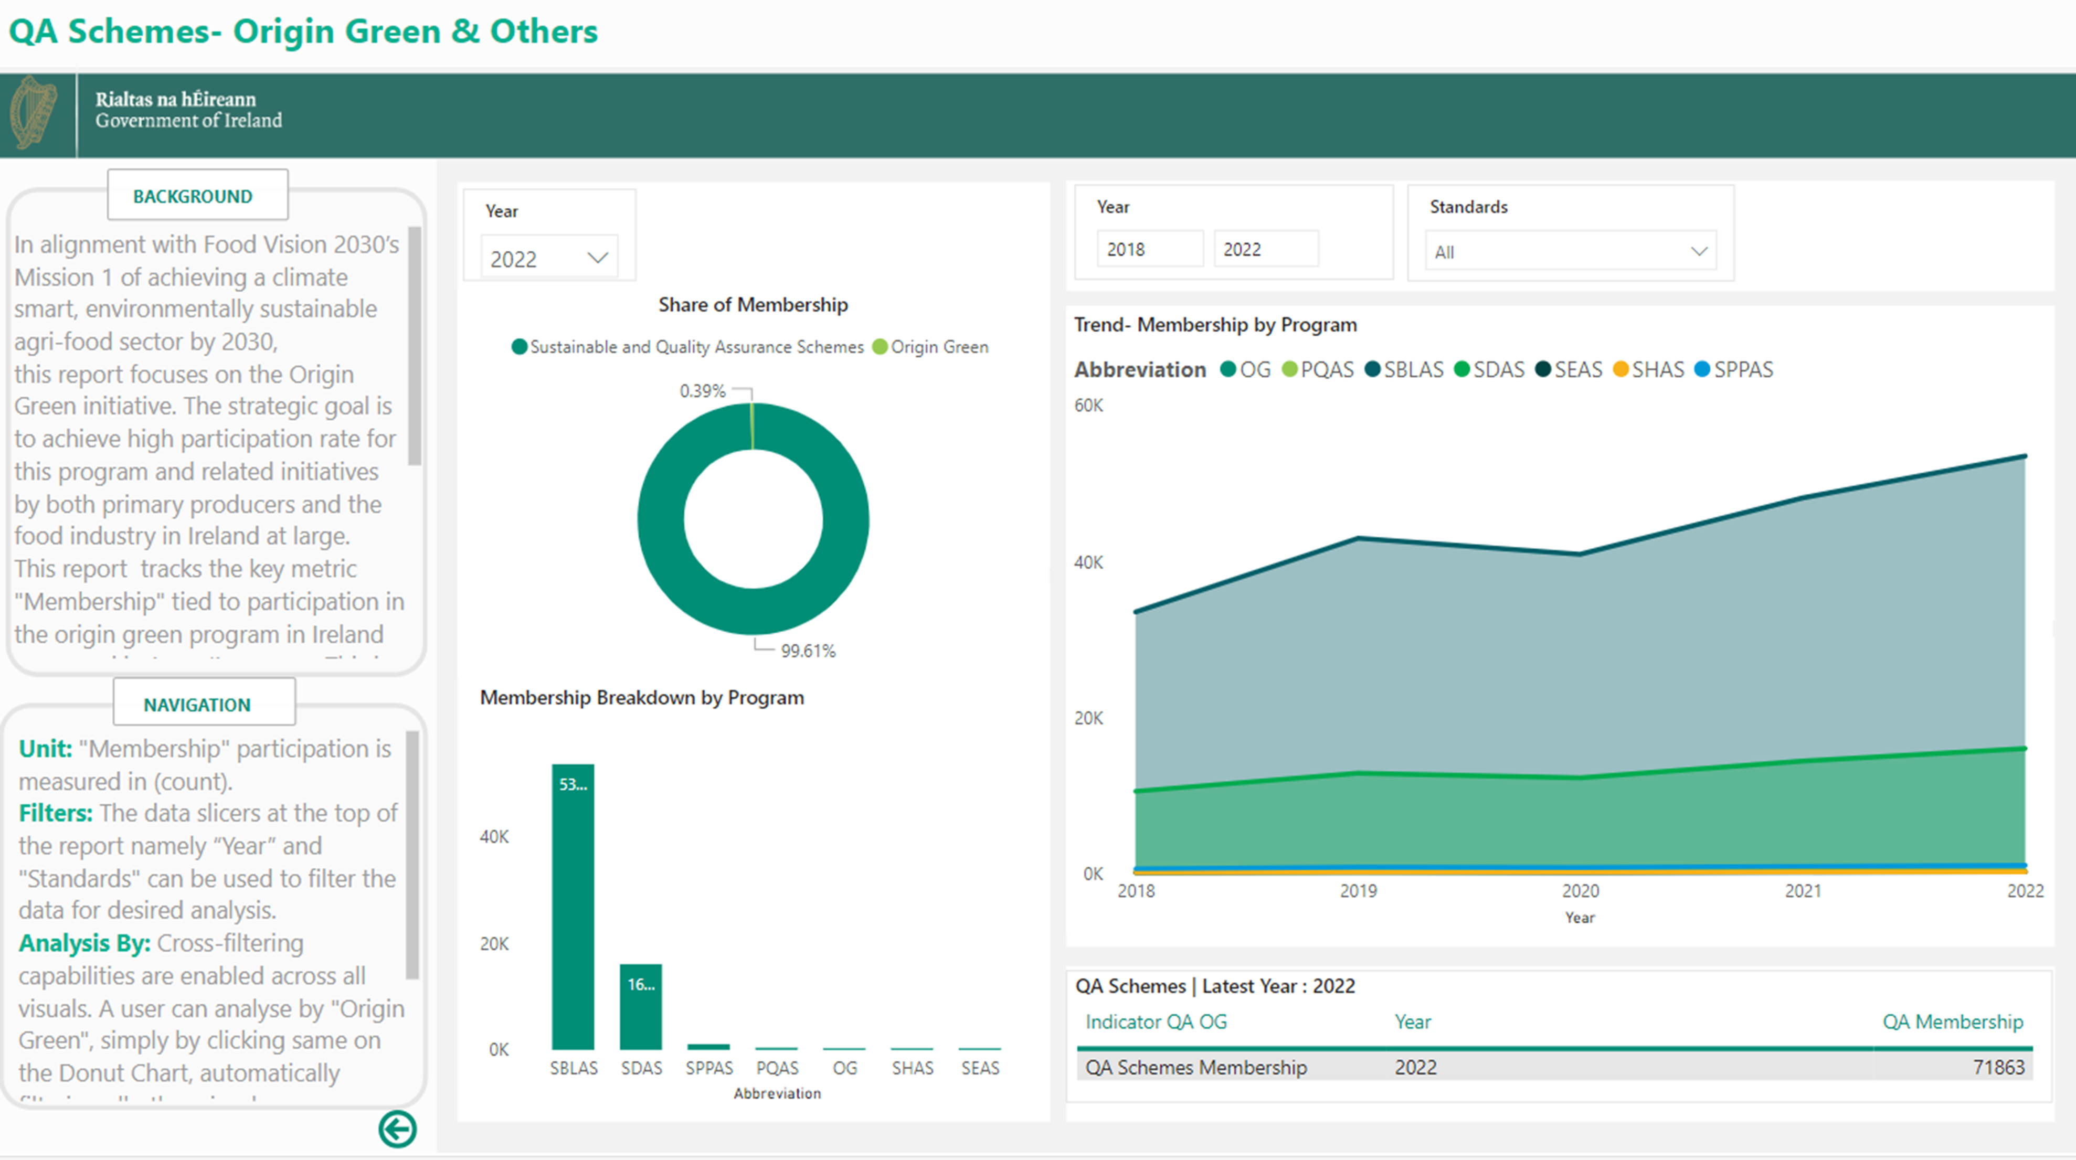
Mission 1

Slide 19
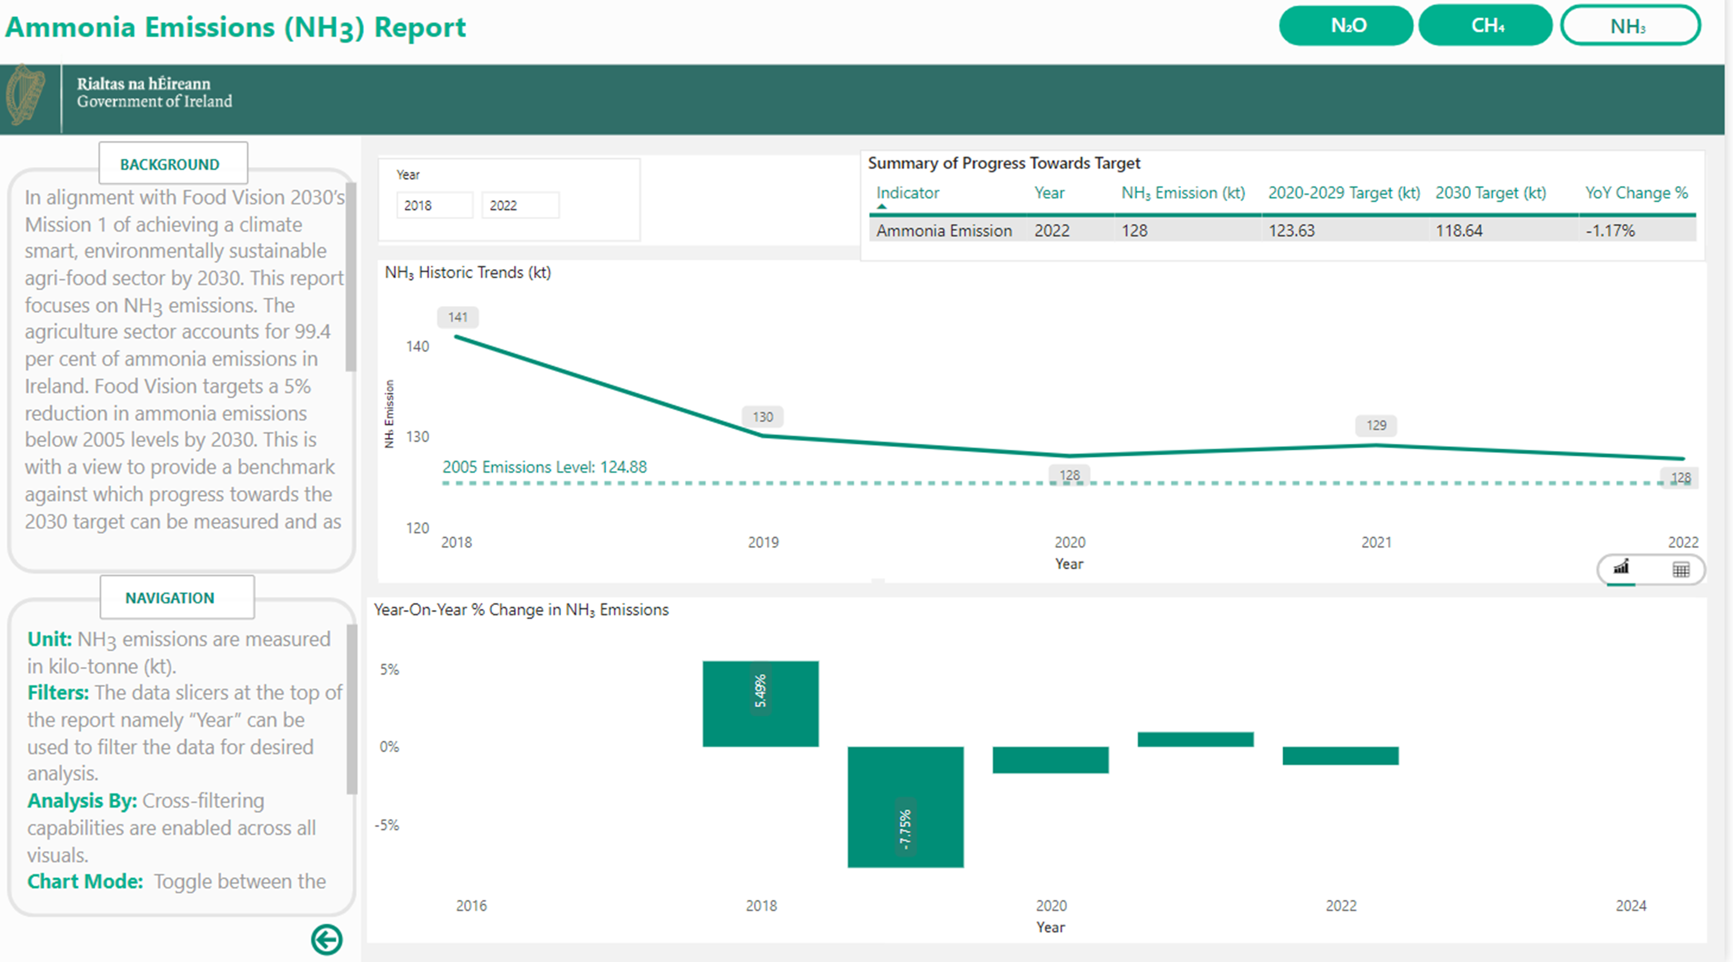
Mission 1

Slide 20
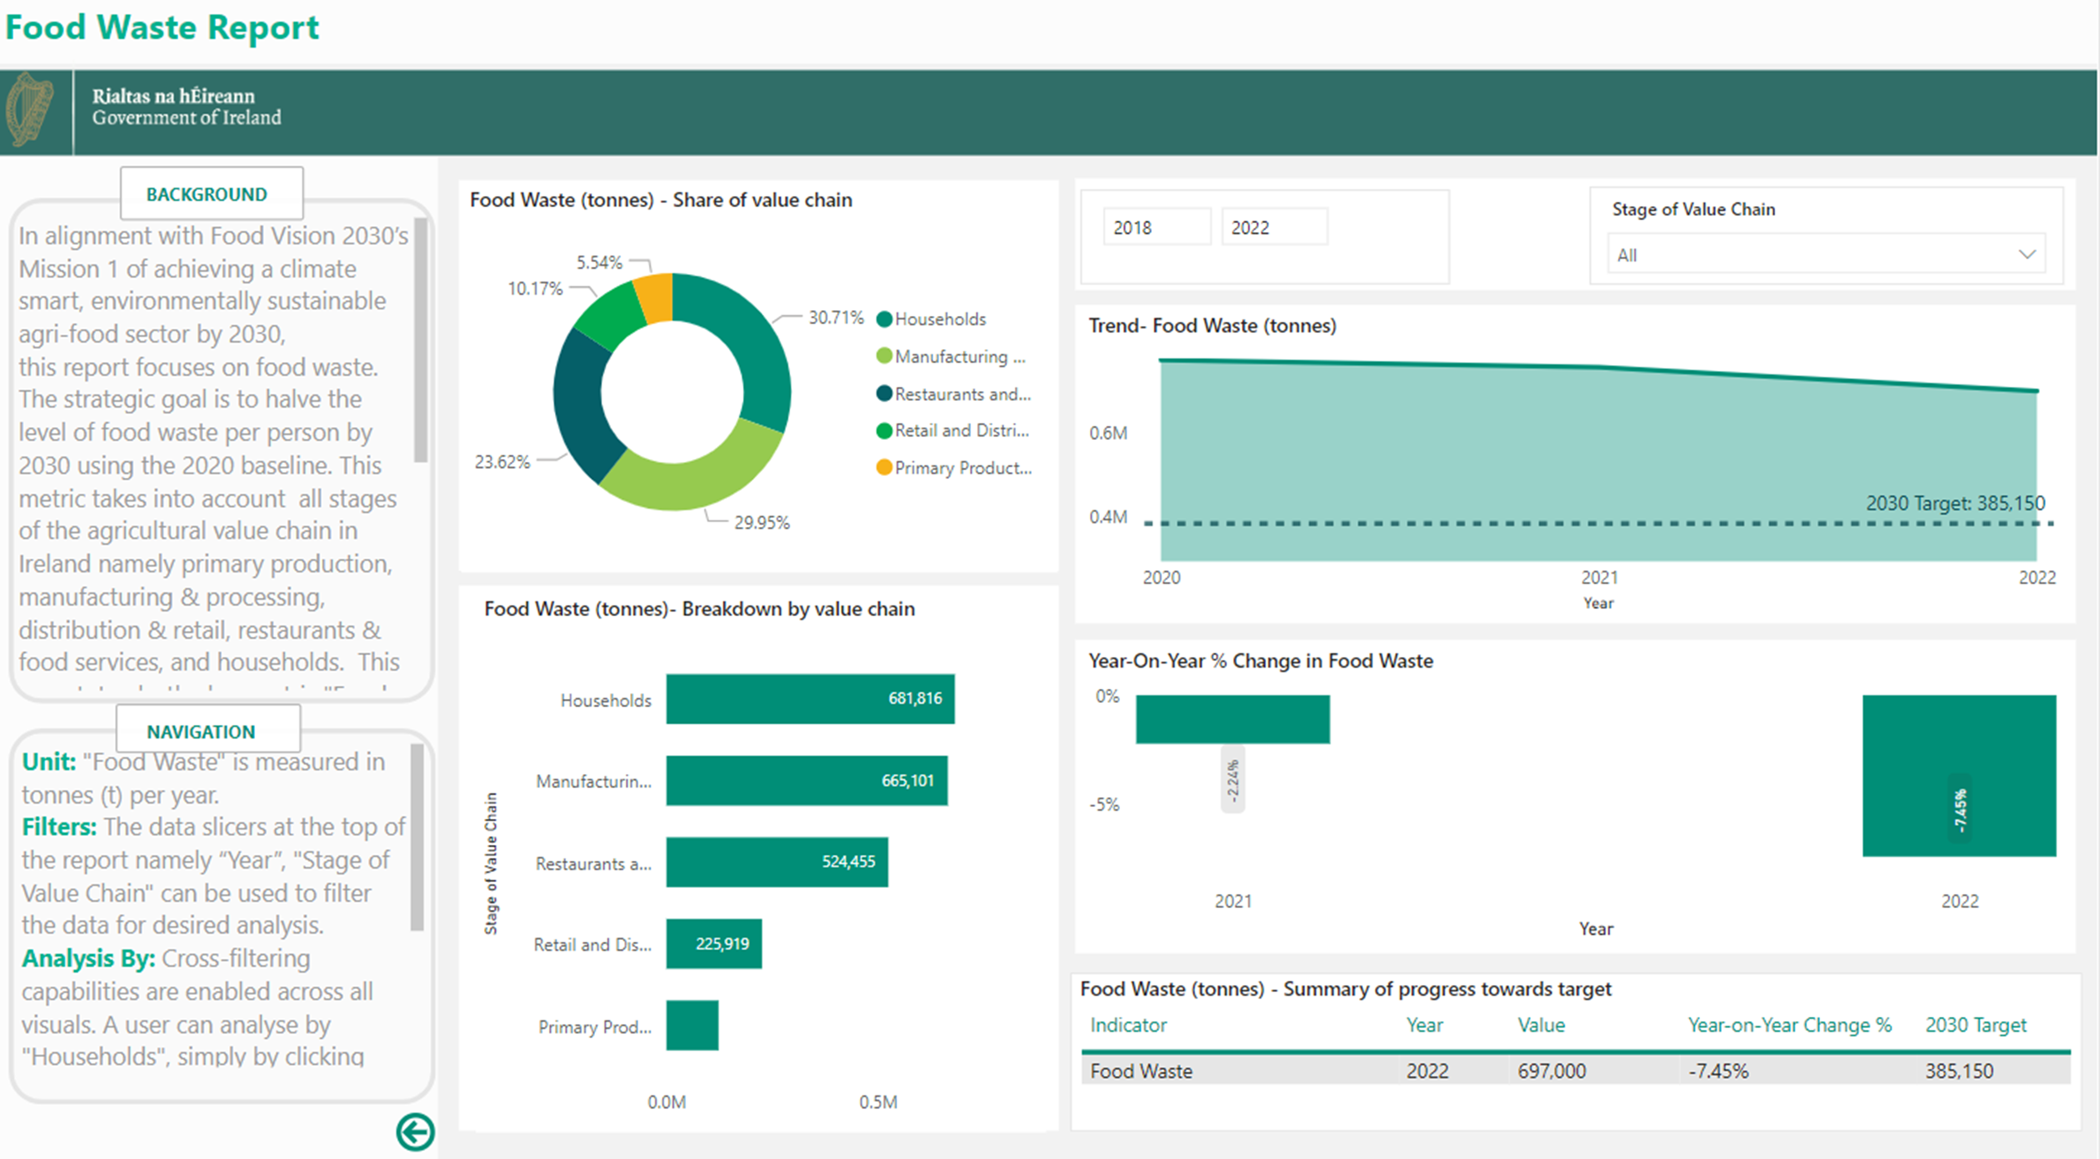
Mission 1

Slide 21
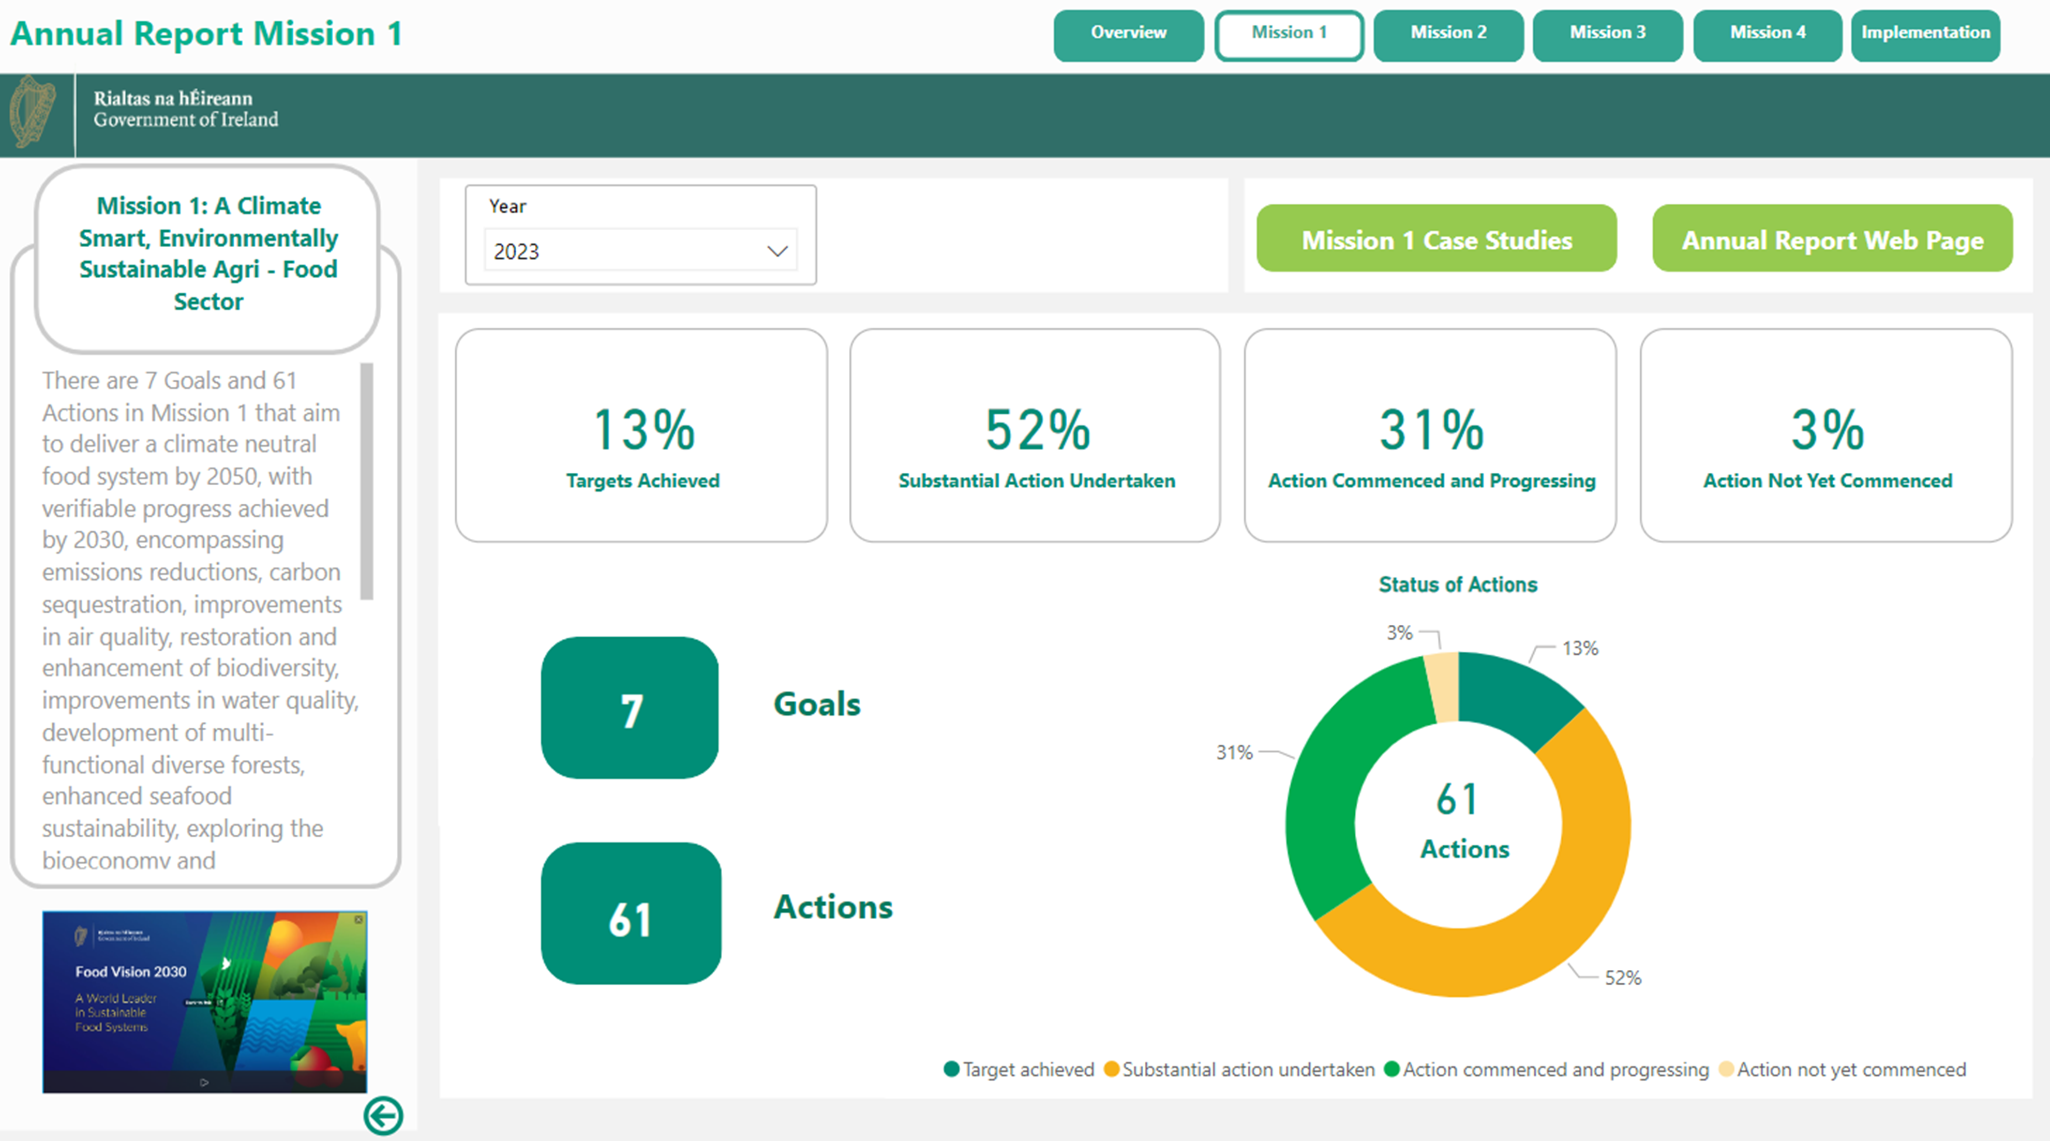
Mission 1

Slide 22
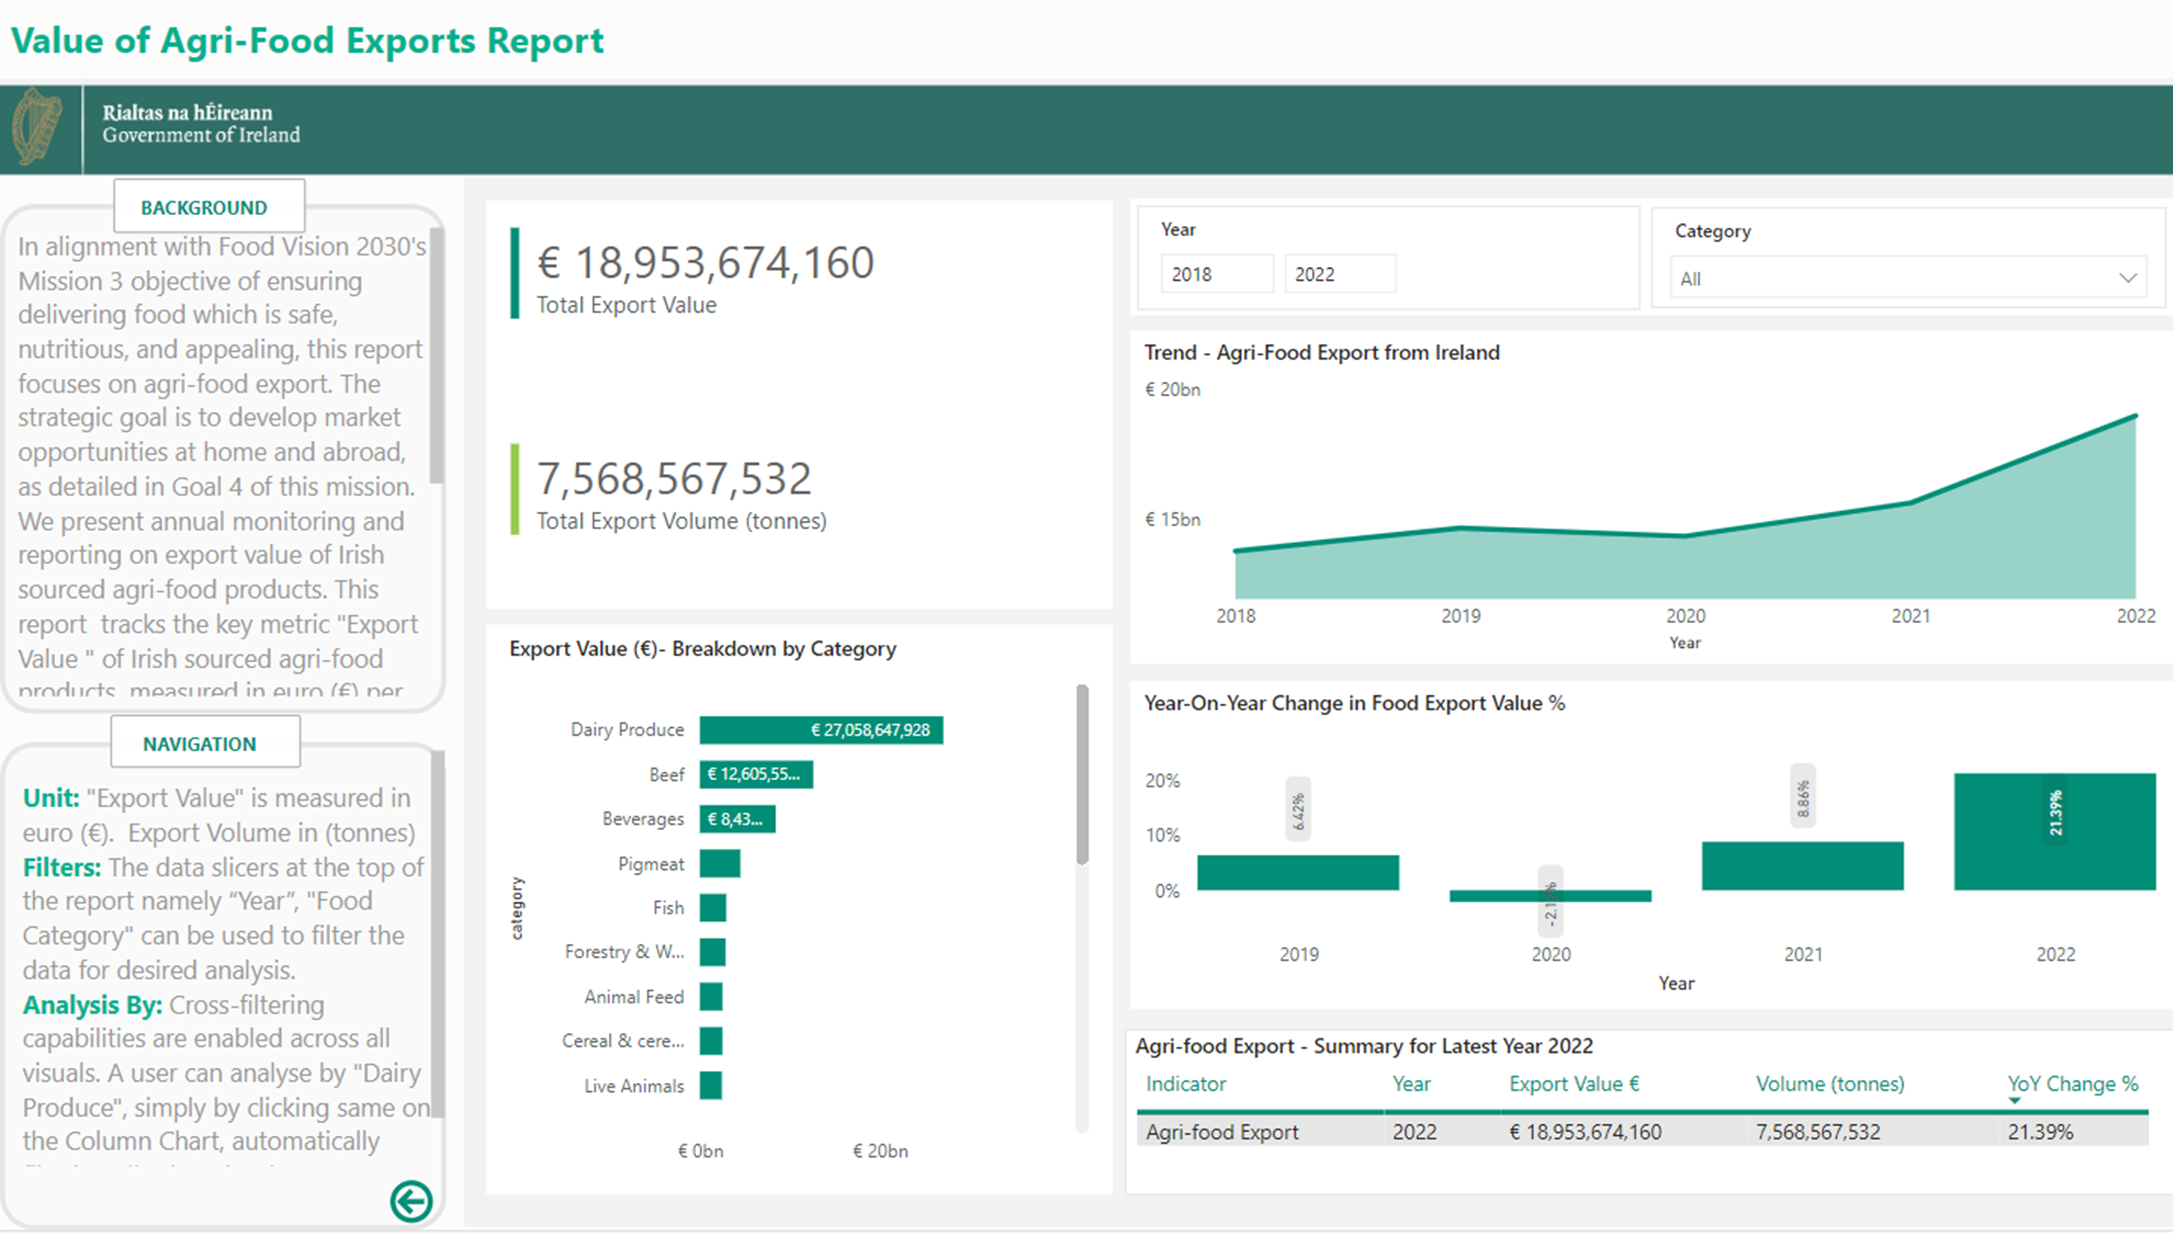
Mission 3

Slide 23
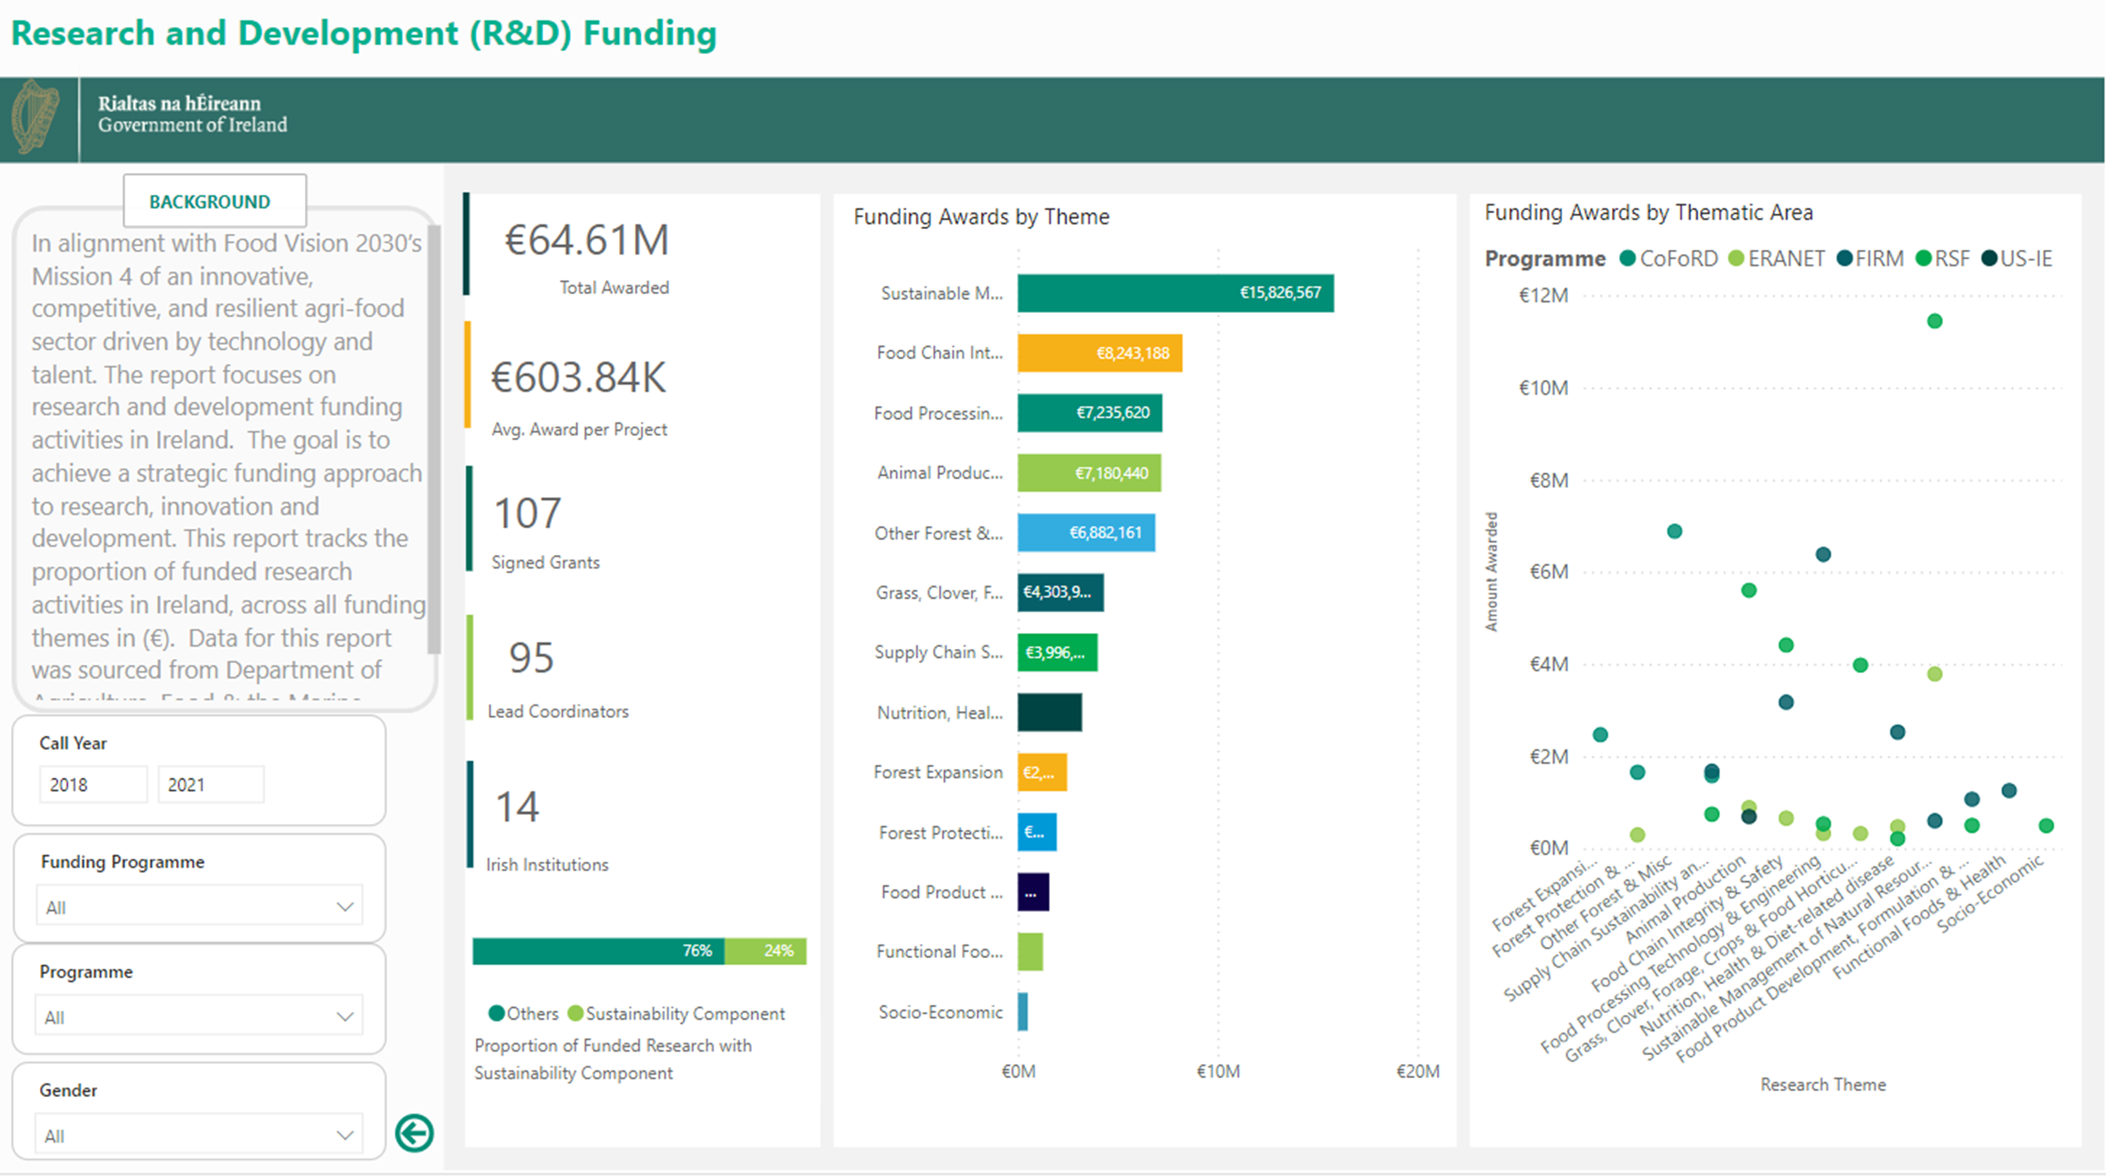
Mission 4

Slide 24
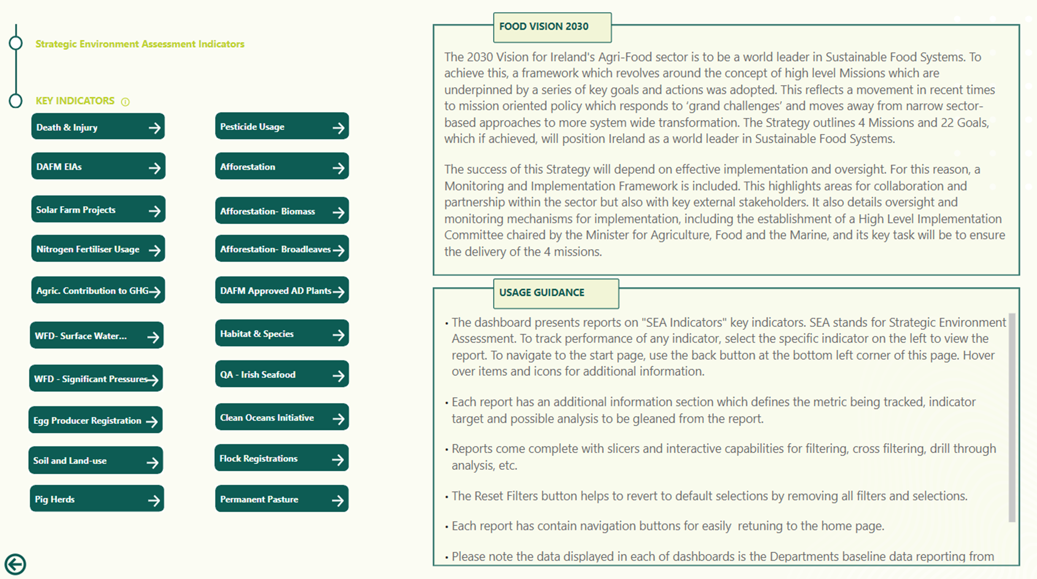
Strategic Environmental Assessment Indicators

Slide 25
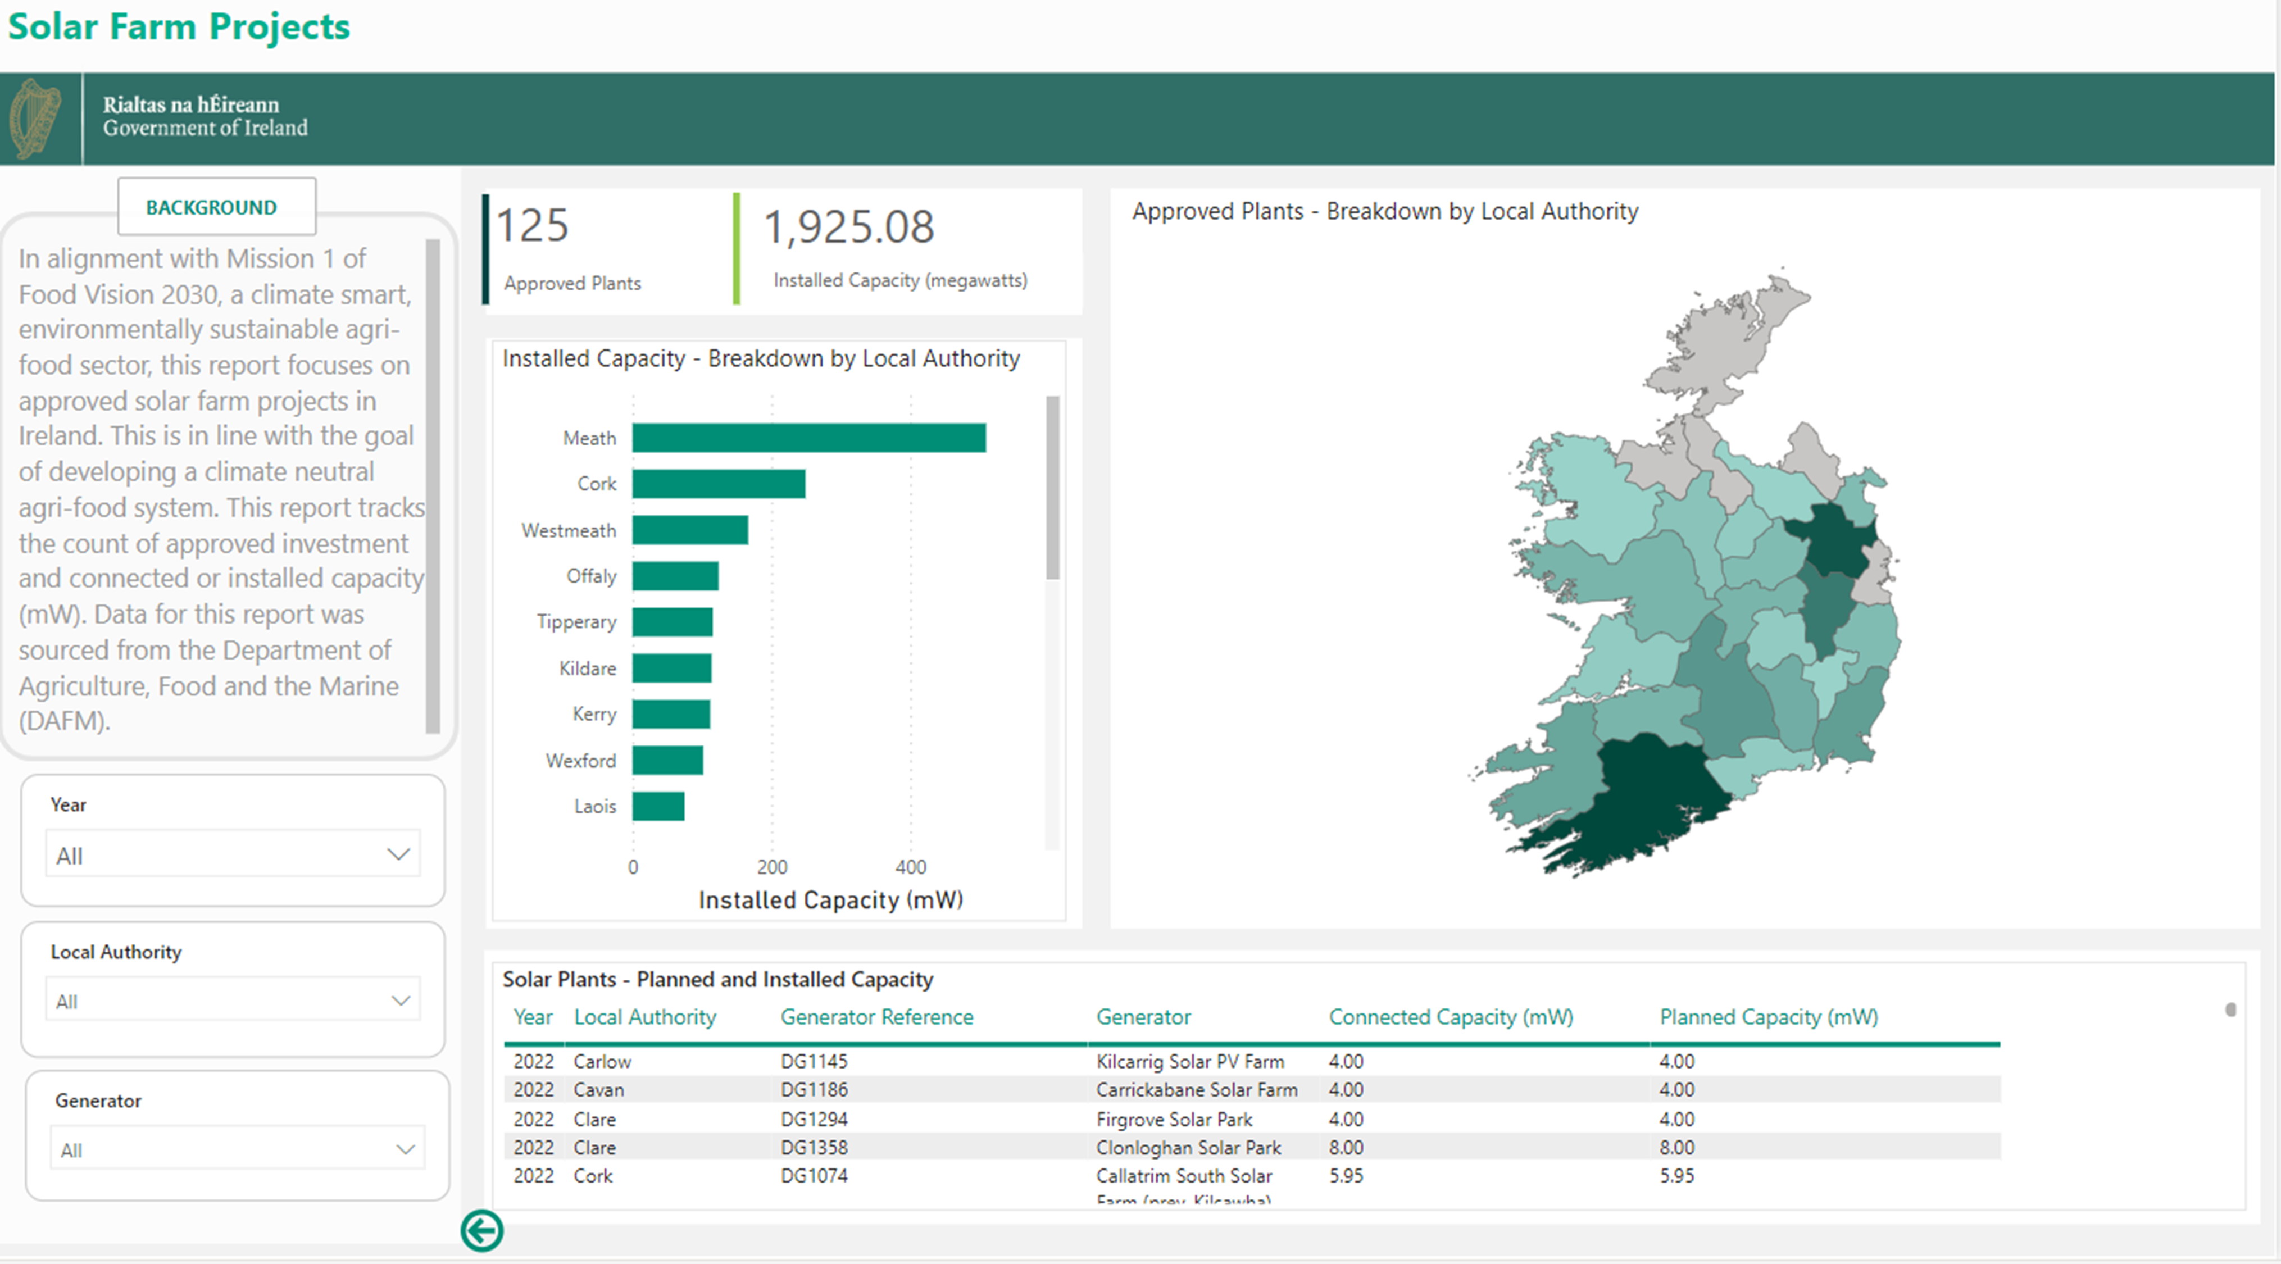
Strategic Environmental Assessment Indicators

Slide 26
Next Steps
Dashboard Updates
Data sources to be updated with 2024 data
Final 2022 / 2023 data to be included where appropriate
Further development of data sources – DAFM Internal and External
Ongoing Annual / Biannual updates
Data maintained in the DAFM Logical Data Warehouse
Economic and Social Indicator Development
High Level Requirements Gathering and Prototype Development in progress
Mission 2 indicators - Family Farm Income, Age Profile, Isolation risk, etc
Mission 3 indicators - Enhanced food safety, animal health & welfare, etc
Mission 4 indicators – Level of private Research & Development, Promotion of food & nutrition security, and Sustainable Food Systems, etc
Phase 2 – on a phased basis in 2025

Slide 27
Thank you and any questions?

