Slide 1


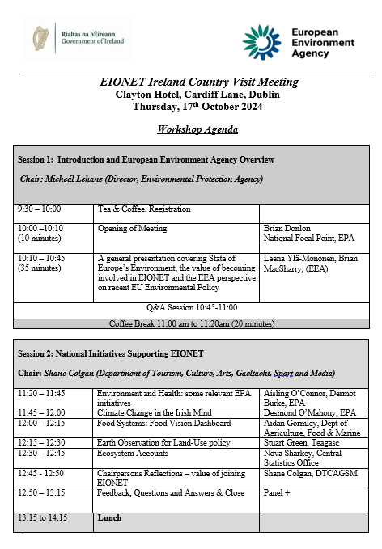
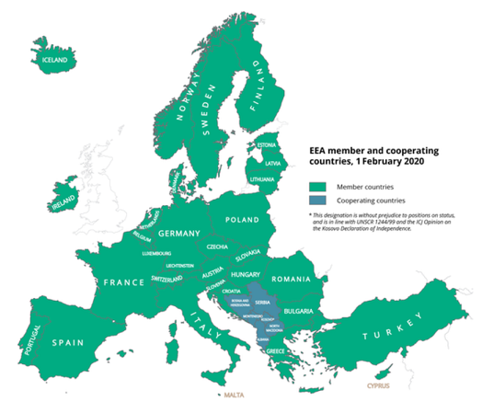

Slide 2
EEA EIONET
EIONET Ireland Network Meeting
Dr. Brian Donlon, EPA Cork
National Focal Point Team
17th October 2024

Slide 3
EEA EIONET
EIONET is a partnership network of the EEA, eight European Topic Centres (ETCs) and a network of almost 2,500 experts from 38 countries in over 400 national environment agencies, environmental ministries and other bodies dealing with environmental information.
EEA-Eionet Vision –is to enable a sustainable Europe through trusted and actionable knowledge for informed decision-making on environment and climate priorities and solutions.
Wide knowledge base
sharing near-real time air quality measurements from across Europe
documenting GHG emissions trends and projections,
providing satellite data on land cover,
delivering integrated assessments on the state of Europe’s environment and climate.

Slide 4

Background
EEA EIONET
Section 52 of the EPA Act 1992 - EPA has legal responsibility for coordinating Ireland’s participation in the EEA-EIONET. “National Focal Point”
Involved in EIONET modernisation and nomination of Irish experts to the 12 Eionet Groups and associated Thematic Groups.
EPA also have role as National Data Flow Co-ordinator
Network contains 100+ experts from 22 organisations
EPA website link to EEA and EIONET

Slide 5
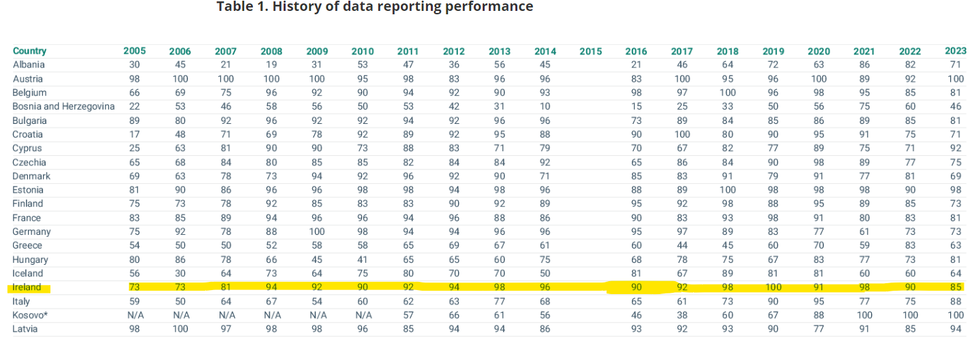
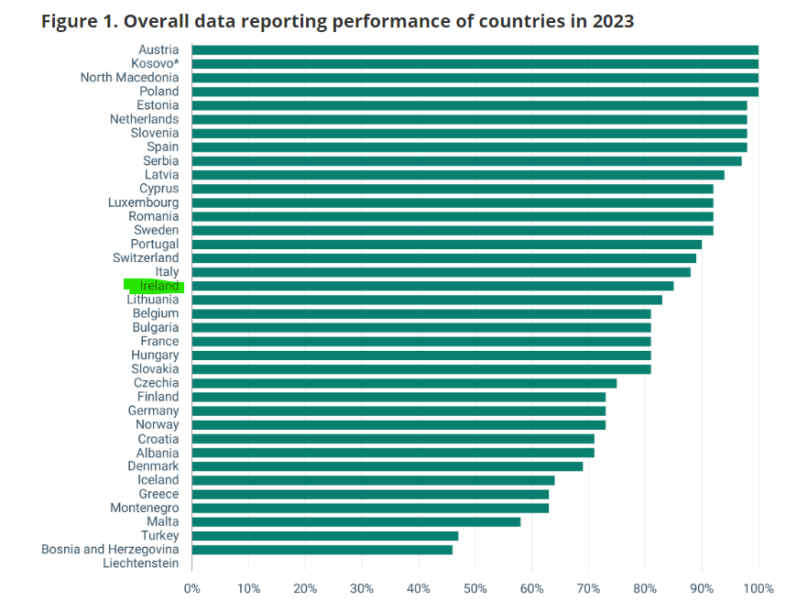
Today EEA handle over 250 times more data than in 2002
Now – Dataflow Co-ordinators in each country (F O’Rourke).

Slide 6
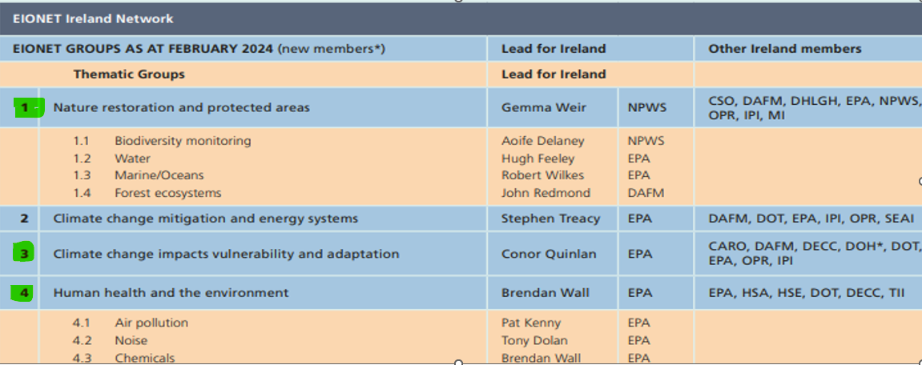
EIONET Ireland Network

Slide 7
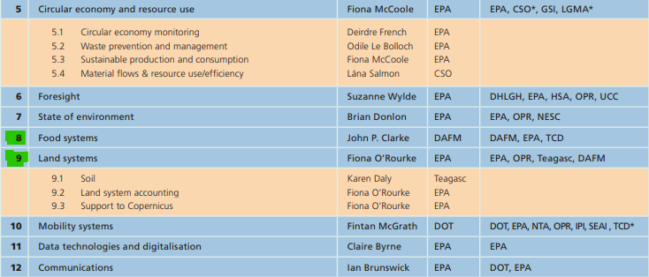
EIONET Ireland Network

Slide 8
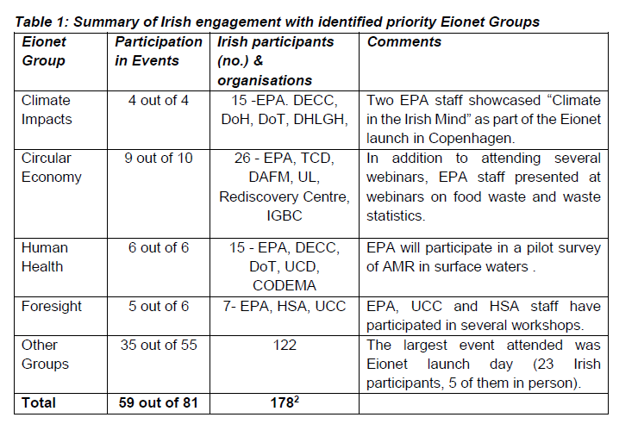
EIONET Ireland update (2023)

Slide 9
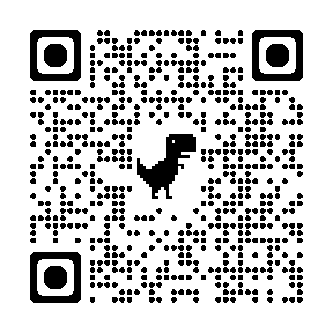
Concluding Remarks
All Eionet group leads identified and nominated by Ireland
Active Engagement in many of the Eionet groups
Very little national involvement in European Topic Centres
Large number of experts initially but many not signed up via Teams
Need outline of work programme (1-2 year) across Eionet Groups (like Horizon Europe)
Thanks to EEA for attending today and for on-going support
EIONET Ireland Network Brochure

