Slide 1
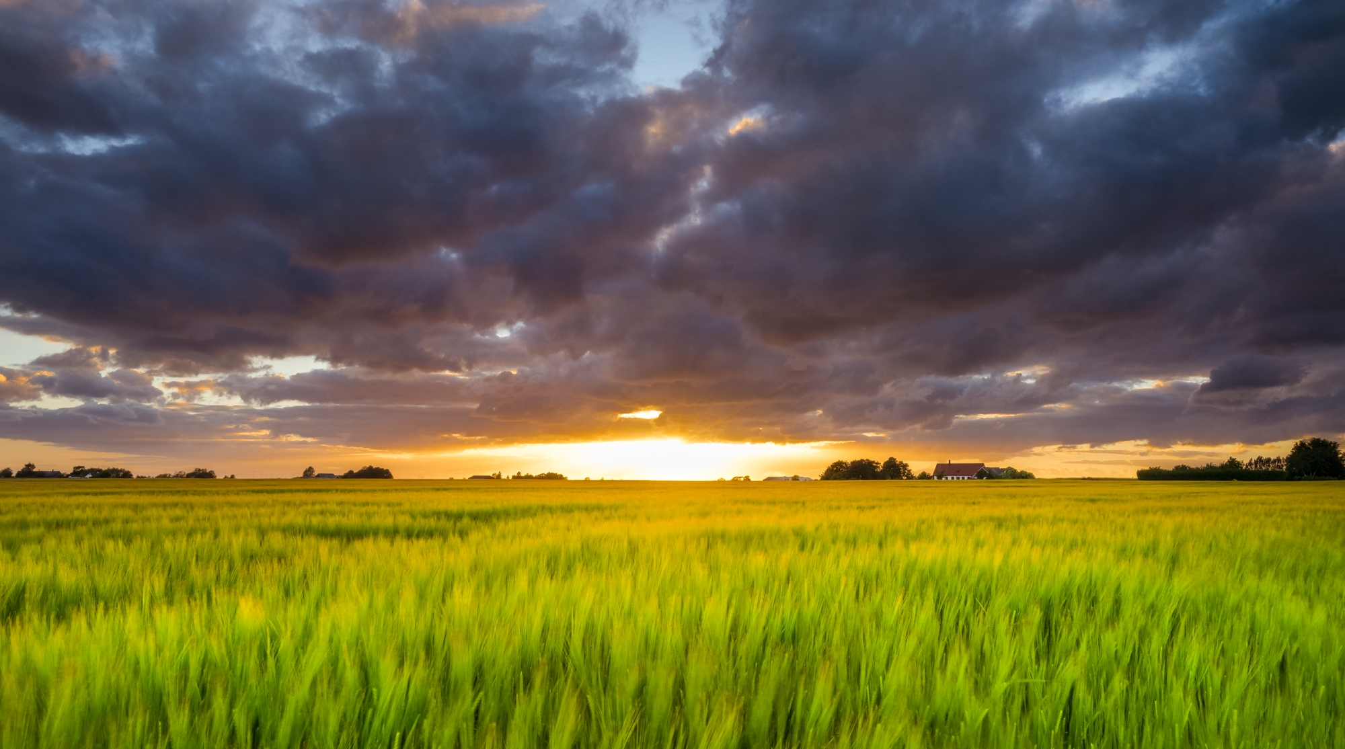
EEA-Eionet supporting the European Green Deal and beyond
Environmental knowledge and systemic approaches
Leena Ylä-Mononen| Ireland Country Visit| 17 October 2024

Slide 2


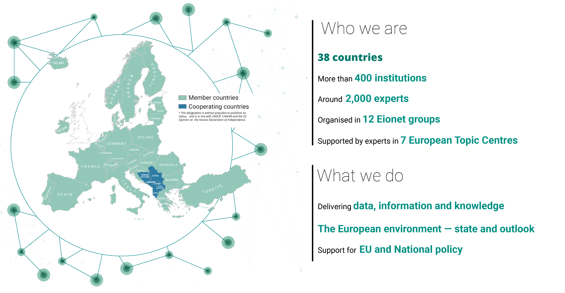

Slide 3
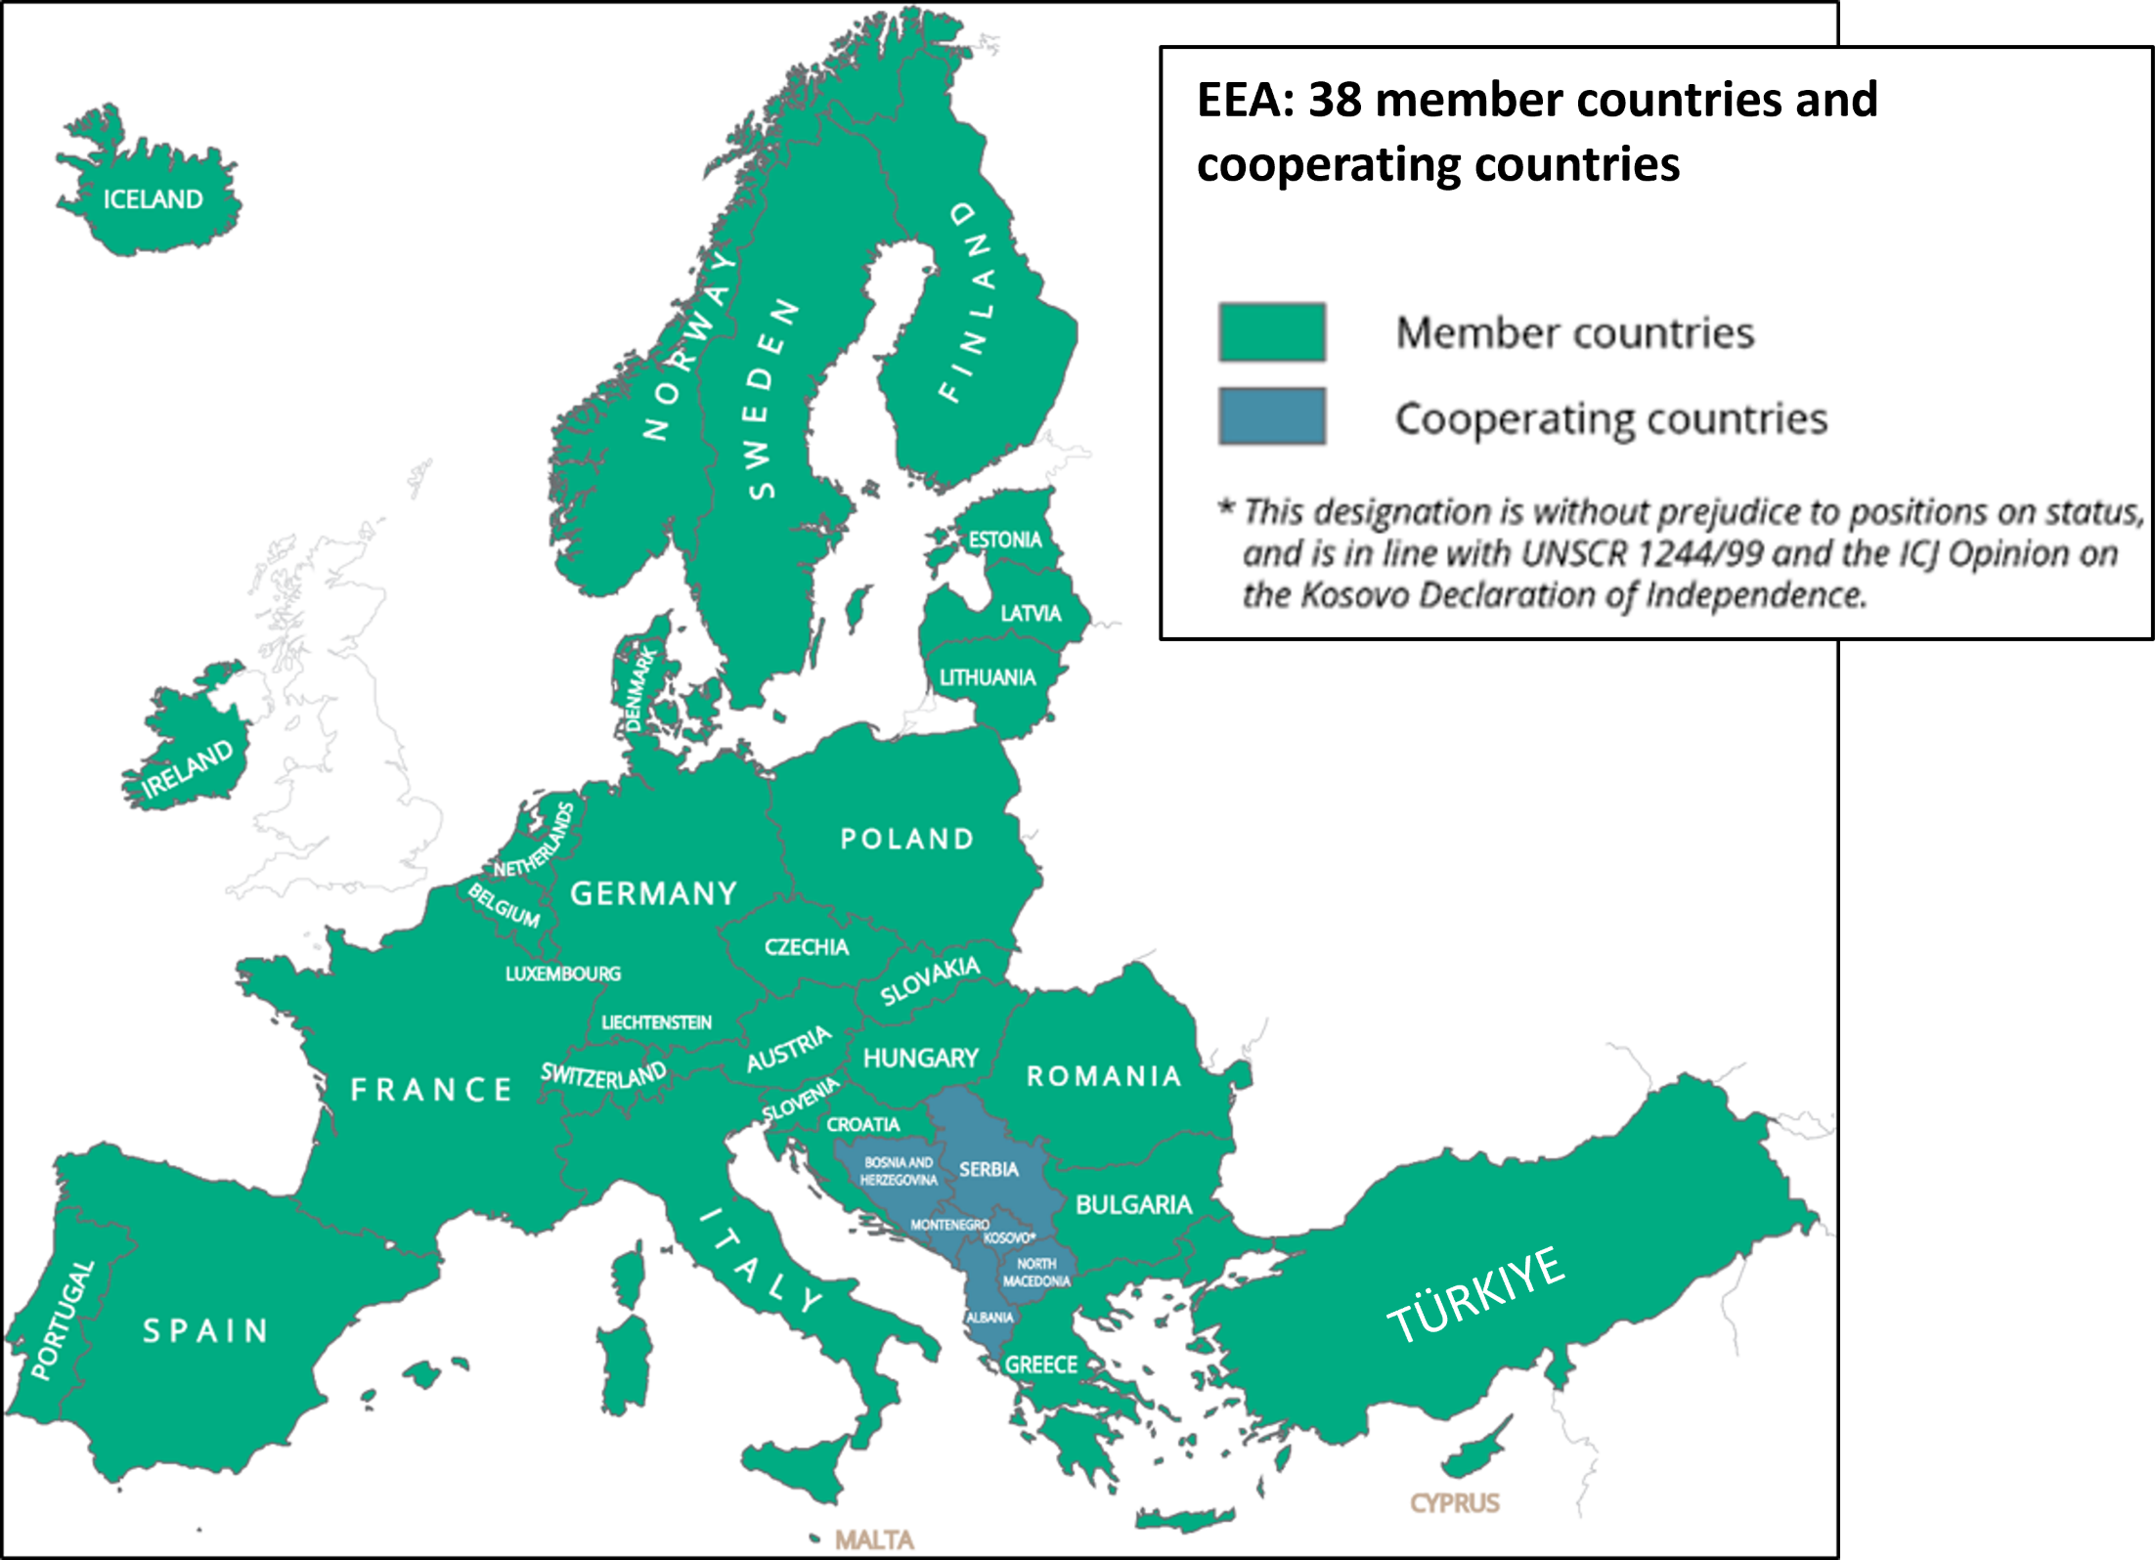
Informing
policy implementation
Assessing systemic challenges
Supporting countries:
Knowledge
co-creation, sharing and use
What we do

Slide 4
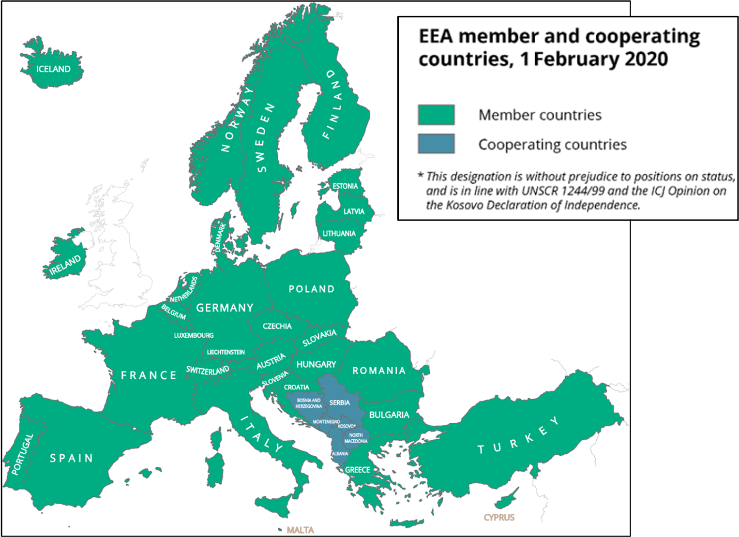
Management board
EEA countries
European Commission
European Parliament
Eionet
EEA
Scientific committee
Governance
EPA network

Slide 5
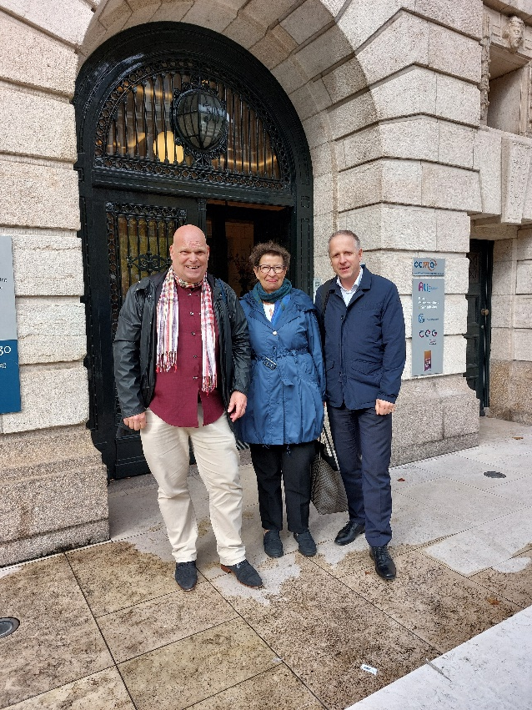
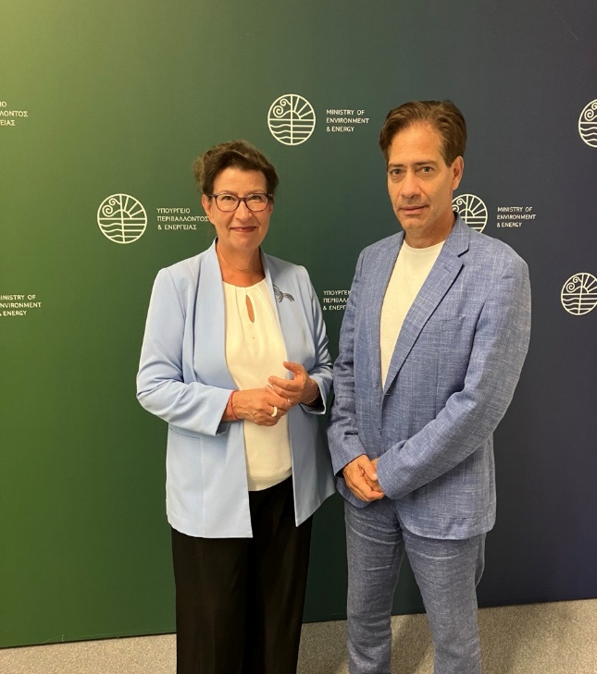
Our engagement in 2024: Country visits
COUNTRY VISITS
Recent visits
Austria, June 2024
Greece, September 2024
Netherlands, October 2024
Italy, October 2024
Upcoming visits
Belgium, November 2024
France, November 2024

Slide 6

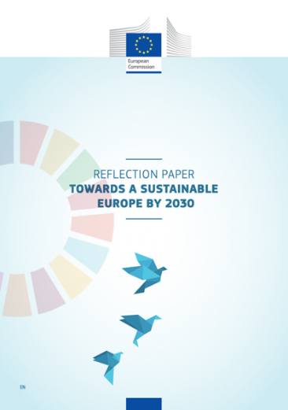


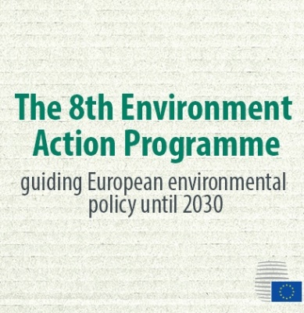





EEA-Eionet: Supporting policy and shaping the policy discourse

Slide 7

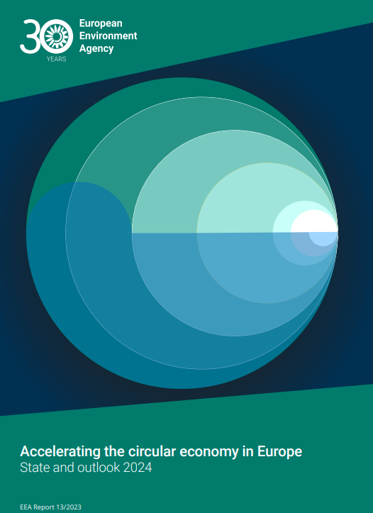
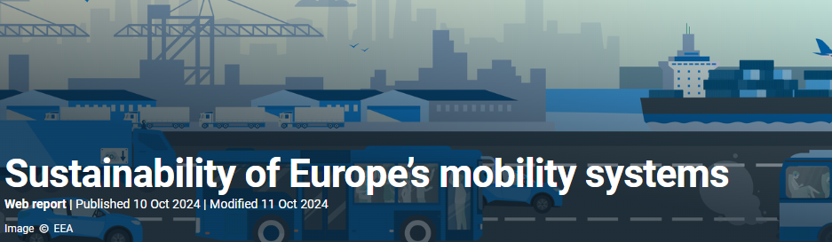



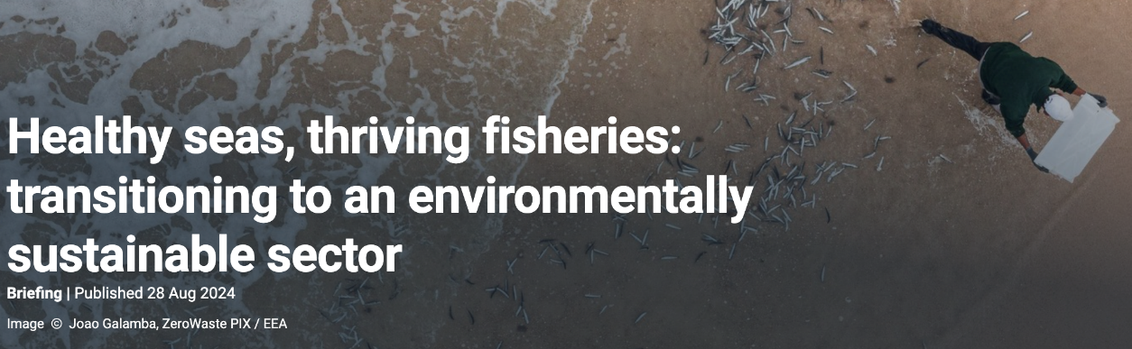
Recent flagship reports and briefings

Slide 8
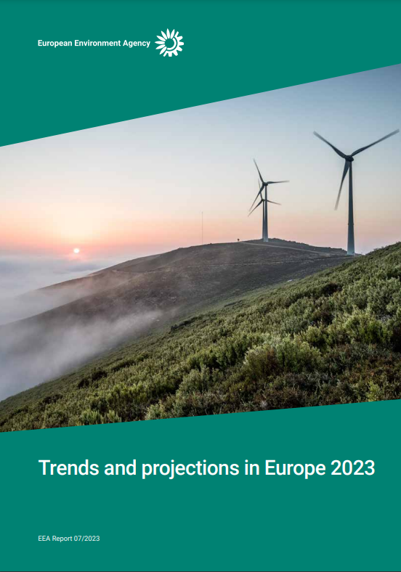
Urban adaptation
Key upcoming publications
State of energy
Zero pollution monitoring report
Offshore wind energy briefing
2024

Slide 9
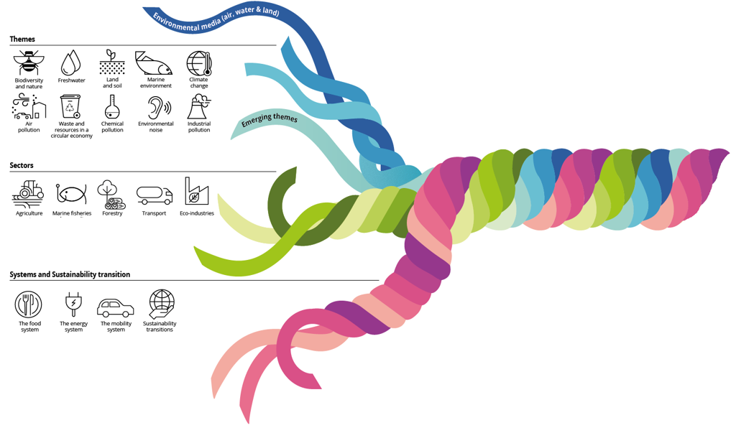















SOER 2025 – an integrated assessment focused on sustainability
Themes
→ Connecting the dots
Biodiversity and nature
Land
and soil
Climate
change
Air
pollution
Chemical pollution
… and other themes
Sectors
Agriculture
Marine
fisheries
Forestry
Transport
Eco-industries
Systems and sustainability transitions
The food
system
The energy
system
The mobility
system
Sustainability transitions

Slide 10







Information and knowledge at the heart of progress to 2030

Slide 11
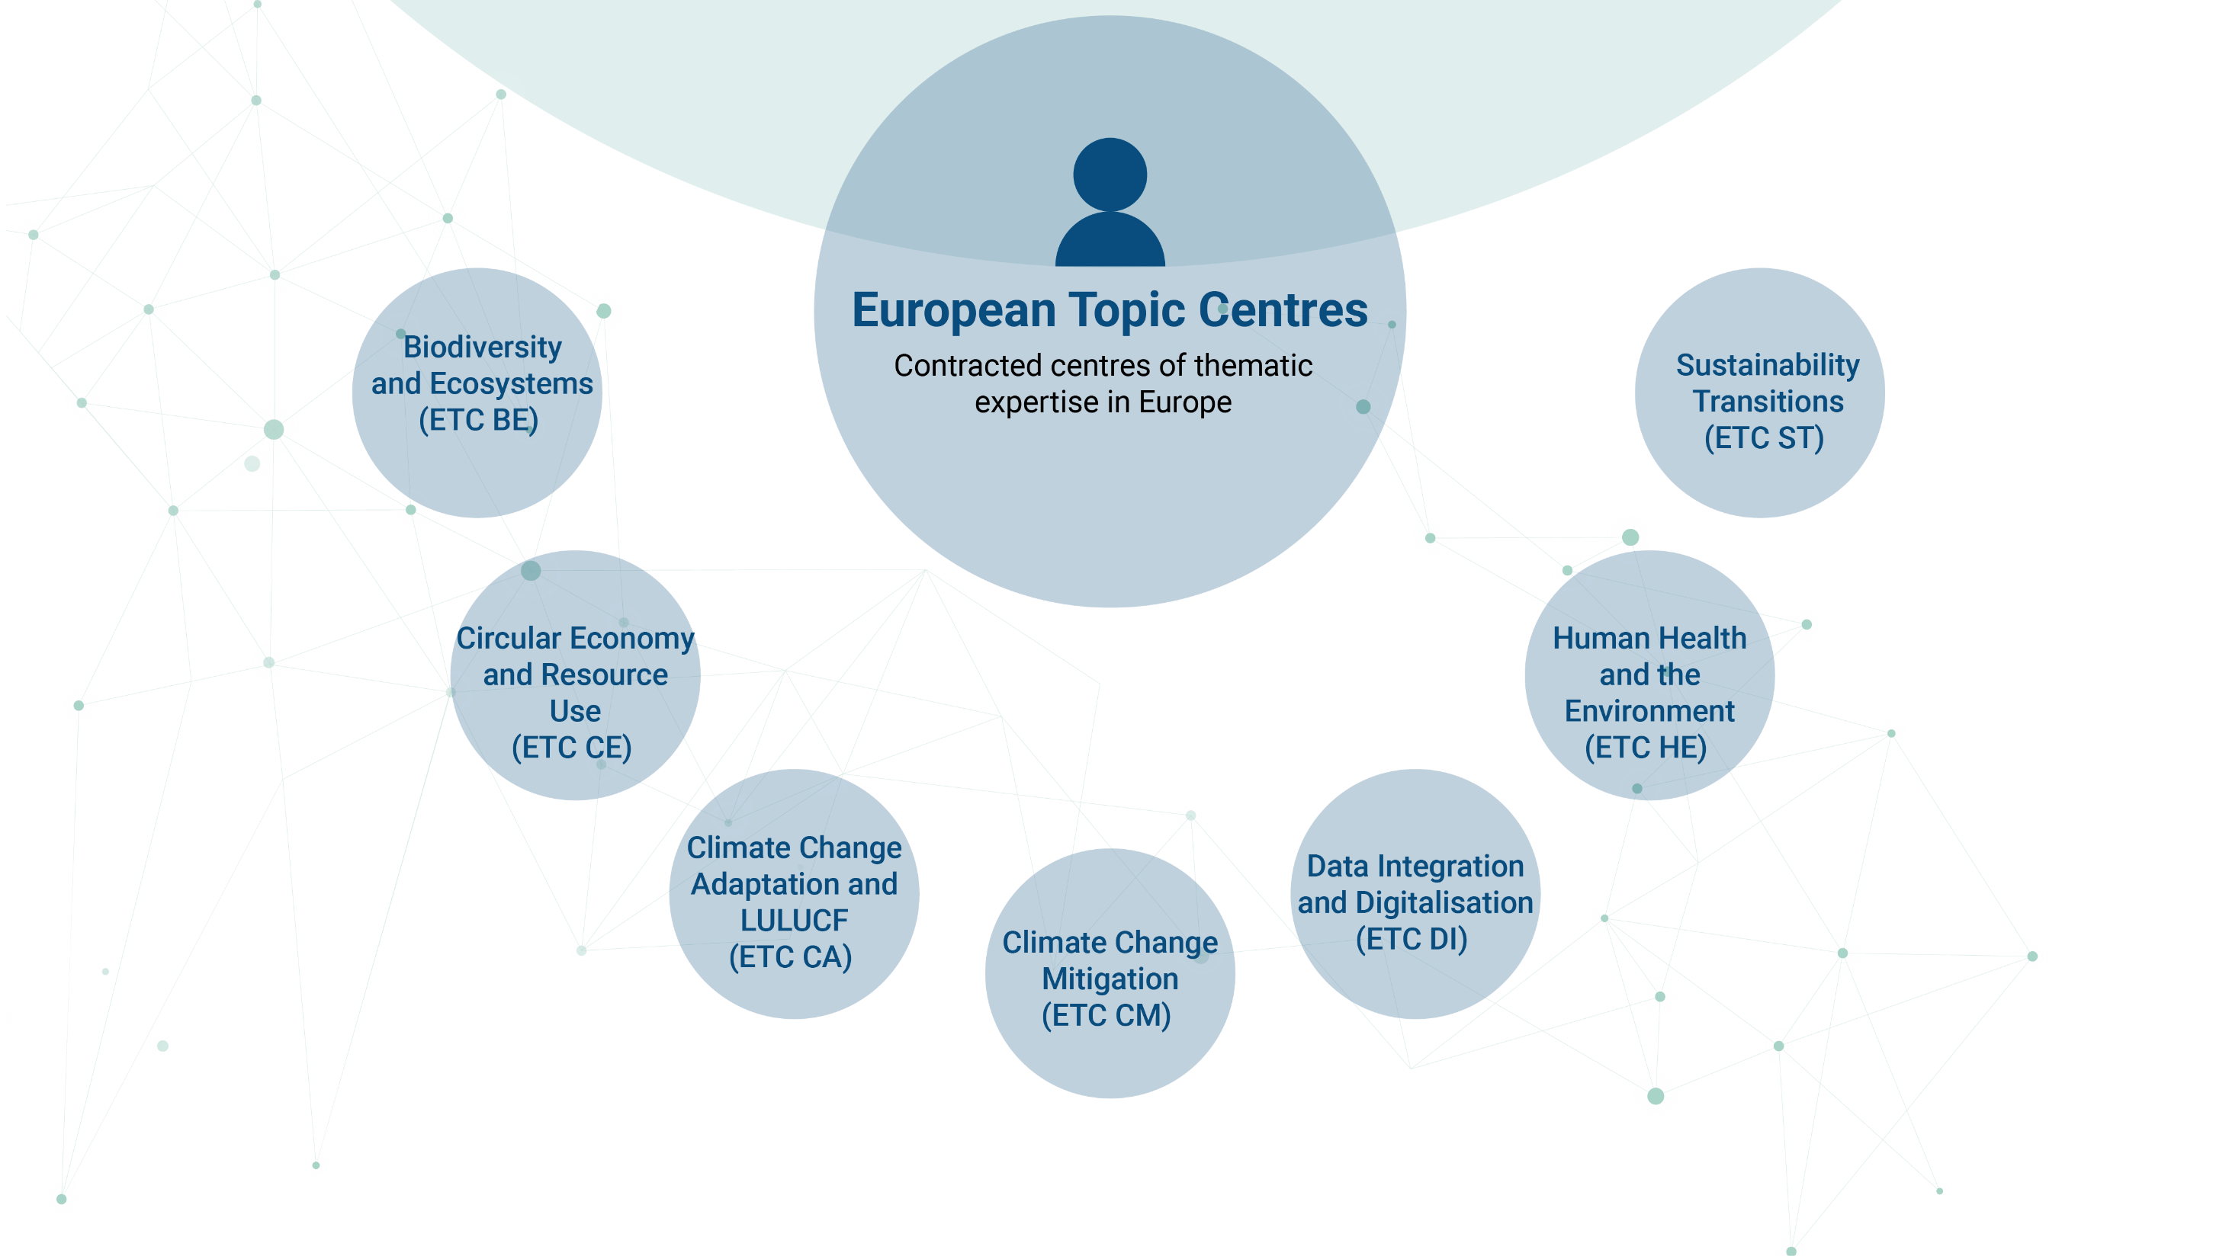


Irish consortium partners

Slide 12
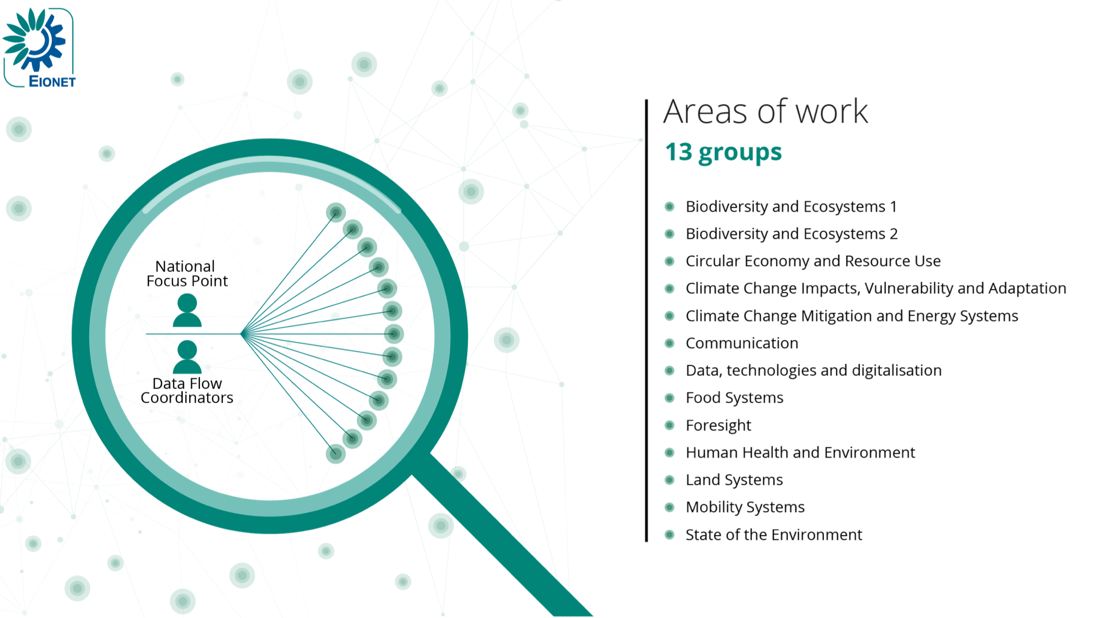
Network power: Working across thematic areas to support EU policy

Slide 13
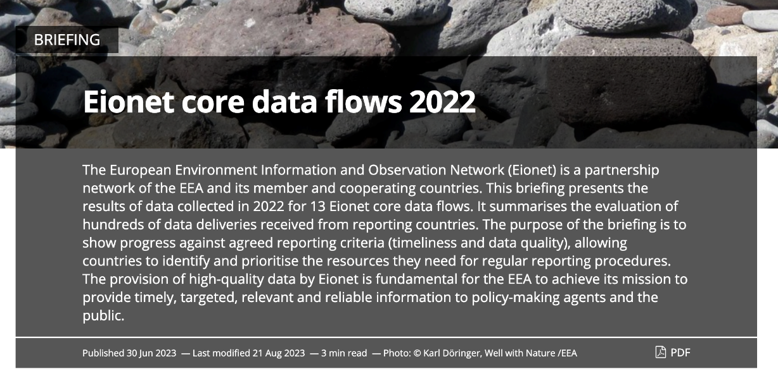
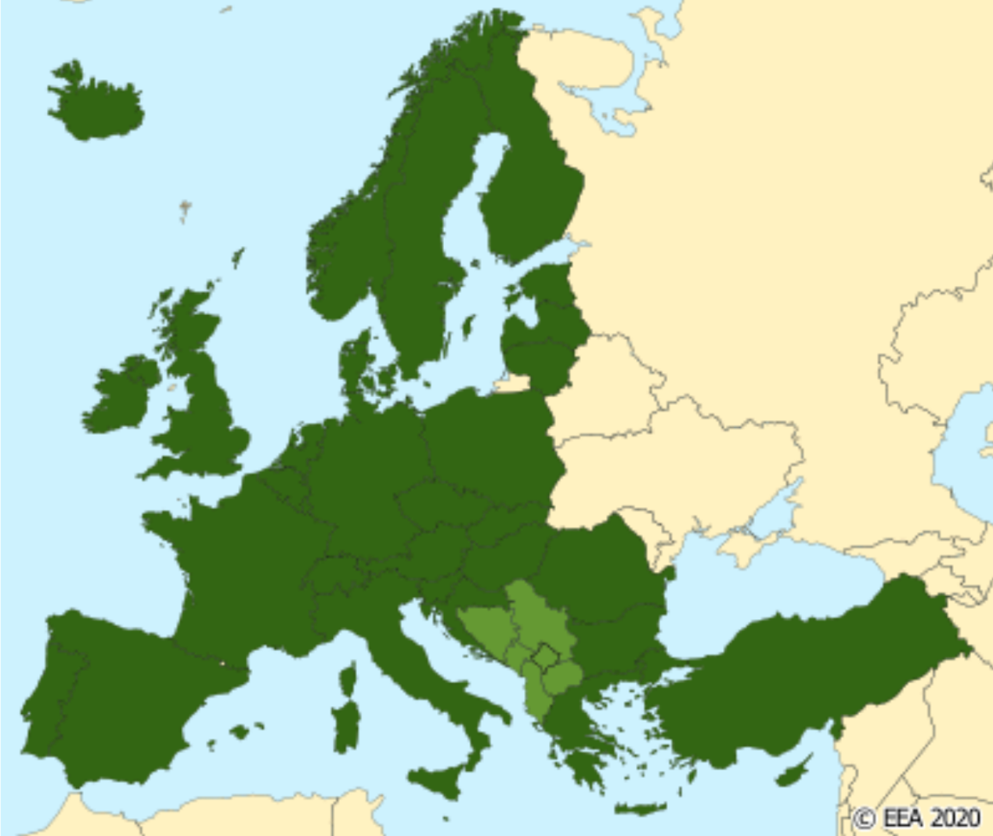
Eionet core data flows
Reported by EEA member and cooperating countries using Reportnet
Selected dataflows used in EEA assessments, products and services
Encouraging countries through friendly competition

Slide 14
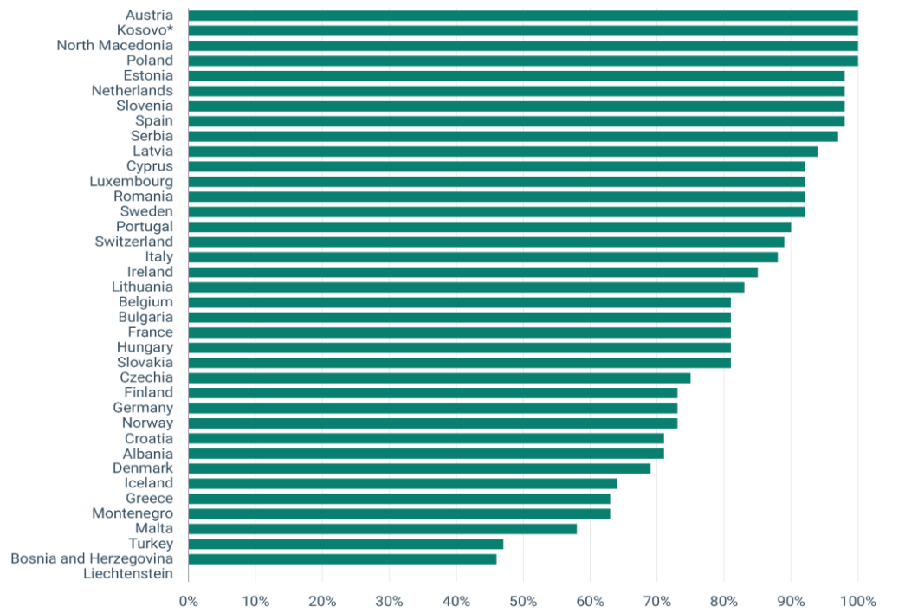
85%
Eionet core data flows 2023: Ireland

Slide 15
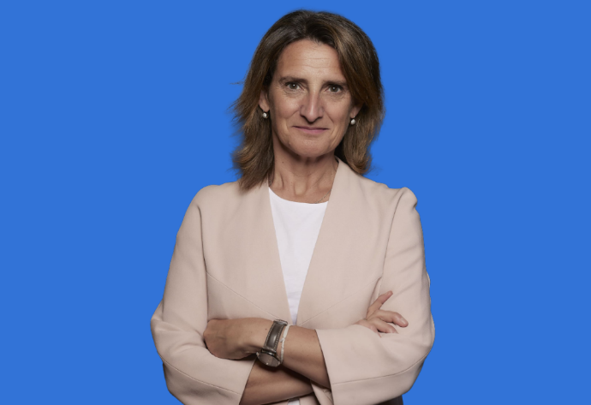
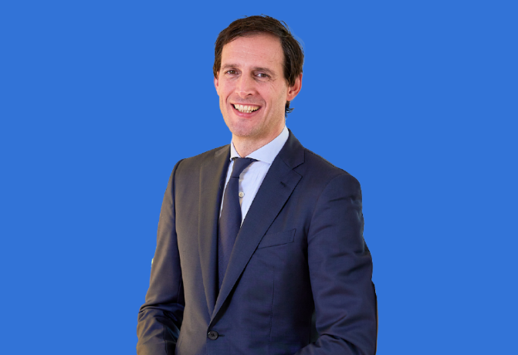
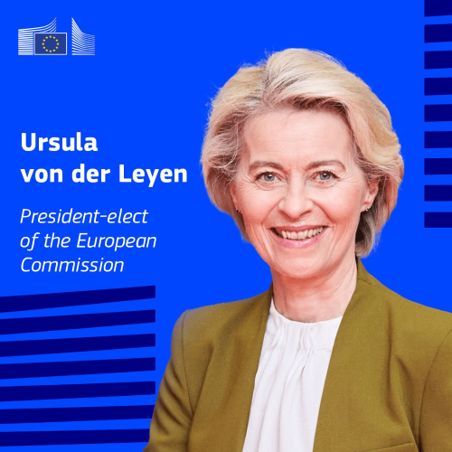

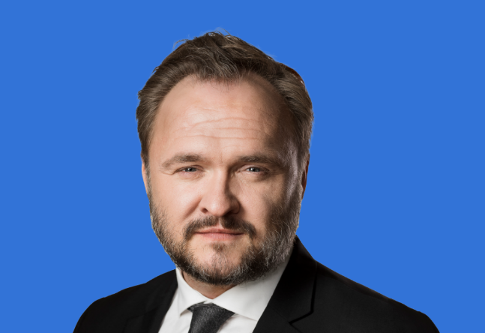

Staying true to the ambitions of the European Green Deal
Teresa Ribera
Executive Vice-President for Clean, Just and Competitive Transition
Wopke Hoekstra
Commissioner for Climate, Net Zero and Clean Growth
Jessika Roswall
Commissioner for Environment, Water Resilience and a Competitive Circular Economy
Dan Jørgensen
Commissioner for Energy and Housing
“
We must and will stay the course on all of our goals, including those set out in the European Green Deal
”

Slide 16





Cooperation moving forward:
Ireland and EEA
Continuing and upgrading EPA’s substantial, extensive and valuable support to Eionet
Engaging national organisations – also outside Eionet – with new knowledge needs
Further support to Eionet modernisation
Facilitating enhanced Eionet participation

Slide 17
Thank you
Leena Ylä-Mononen| Ireland Country Visit| 17 October 2024

