Slide 1
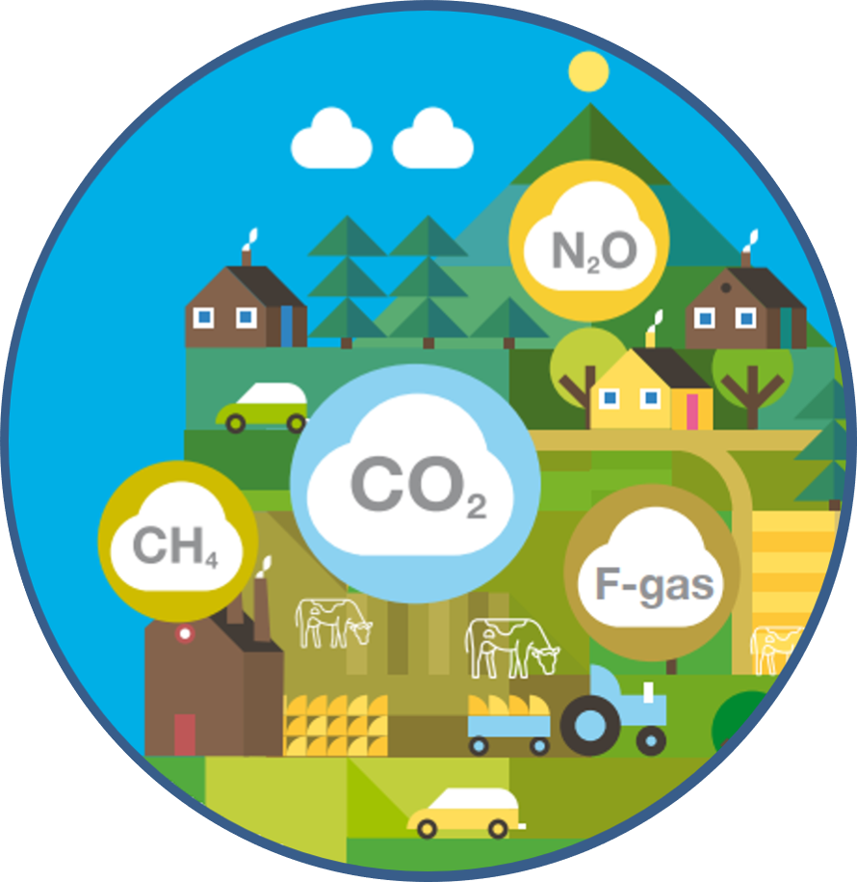
Provisional greenhouse gas emissions 1990-2019
EPA Emissions Statistics team, November 2020

Slide 2
Outline
Highlights and overall Trend
Sectoral Trends and Drivers
Compliance and future targets

Slide 3








EPA Climate Science Activities
Research
Emissions Trading & Registry
Climate Secretariat
Environmental Assessment & Strategic Environmental Assessment
Intergovernmental Climate Science
Industrial & Chemical Regulation
Resource Efficiency & Behavioural Change
GHG Inventories & Projections
Climate Dialogue

Slide 4




Welcome Reduction in overall GHG emissions.
2019 total national greenhouse gas emissions
are estimated to have declined by 4.5% on
2018 levels to 59.90 million tonnes carbon dioxide equivalent.
Less Coal means less emissions
from electricity generation. Almost 70% less coal used in electricity generation in 2019 vs 2018
Less fertiliser and lime use reduces Agriculture Emissions. Reduction in emissions may be difficult to sustain given dairy cow numbers increase

Slide 5
Highlights
Provisional greenhouse gas emissions data for 2019 indicate that Ireland will exceed its 2019 annual limit under the EU’s Effort Sharing Decision (ESD) by 6.98 Mt CO₂eq.
Energy Industries emissions show a decrease of 11.2% (1.19 Mt CO₂eq) in 2019, due to a 69% decrease in coal and an 8% decrease in peat used in electricity generation.
Agriculture emissions decreased by 3.9% (0.86 Mt CO₂eq) in 2019, driven by reduced nitrogen fertiliser use (-10.1%) and a 25.4% reduction in lime used on soils.
Greenhouse gas emissions from the Residential sector decreased by 7.3% or 0.52 Mt CO₂eq with coal use down 29%, peat down 7%.
Transport emissions decreased only marginally, by 0.3% as more biofuel (+22%) was offset by increased demand (+0.8%)

Slide 6
Highlights table

Slide 7
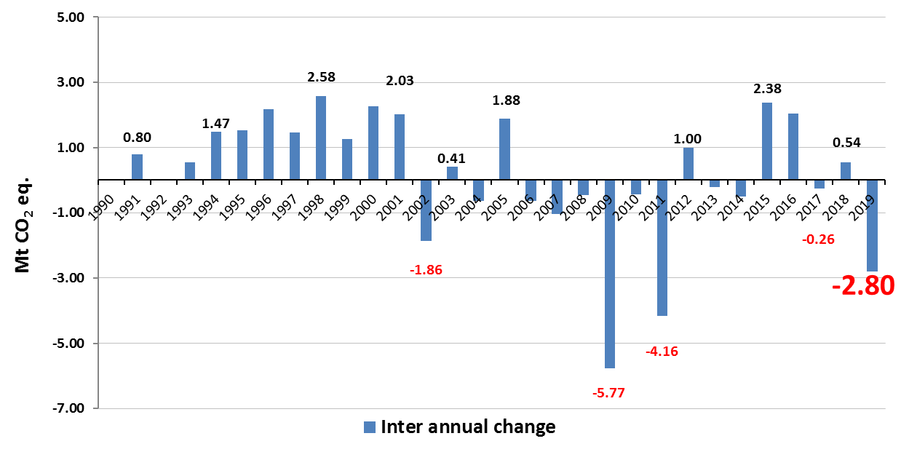
Annual Emissions trends

Slide 8
Highlights 2

Slide 9
Sectoral Share of GHG emissions

Slide 10
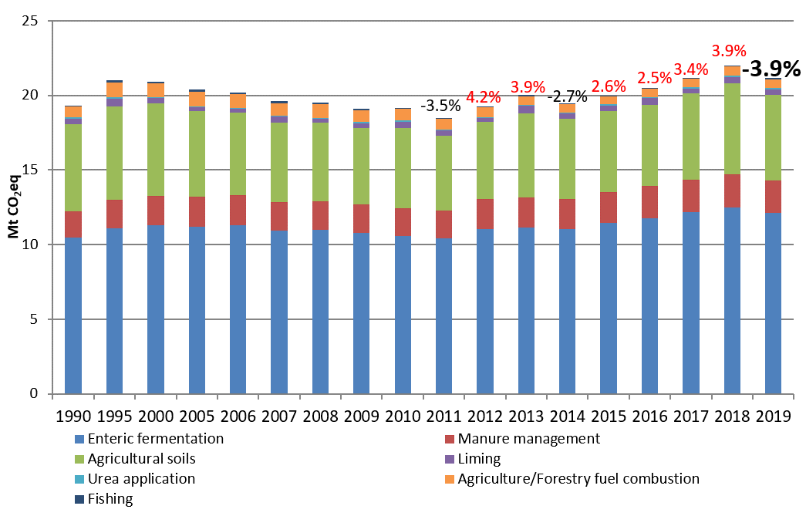
Agriculture

Slide 11
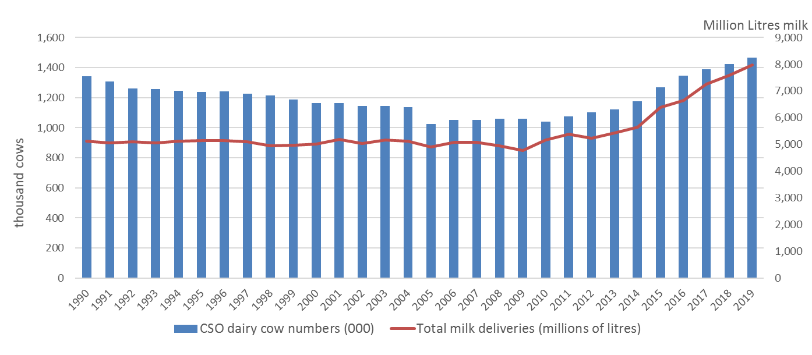
Agriculture emissions drivers

Slide 12
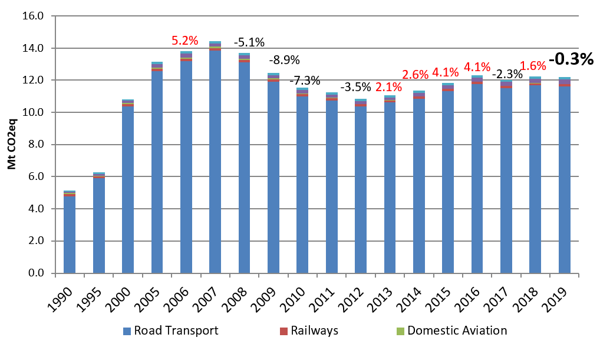
Transport

Slide 13
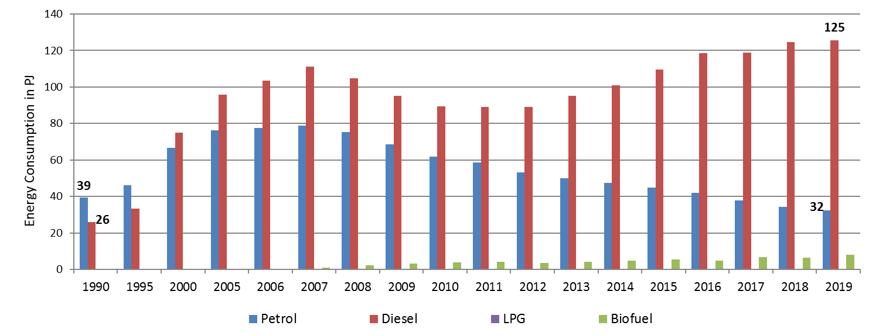
Transport emissions drivers
8

Slide 14
Transport (International Aviation)

Slide 15
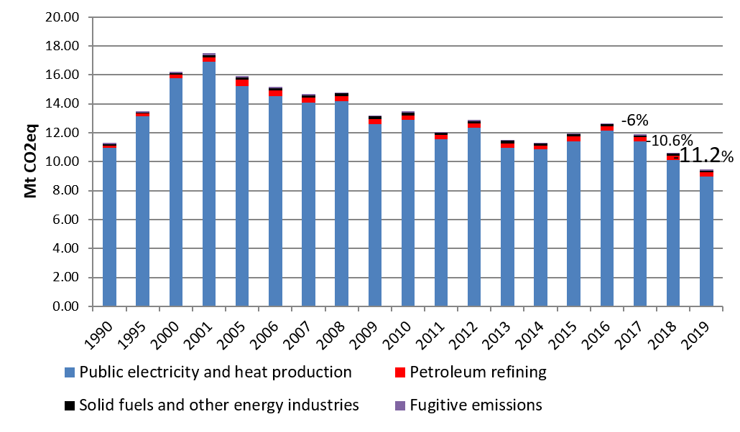
Energy Industries
17.5 Mt
+54%
-46%
Overall emissions in 2019 are 16.6% below 1990 levels

Slide 16
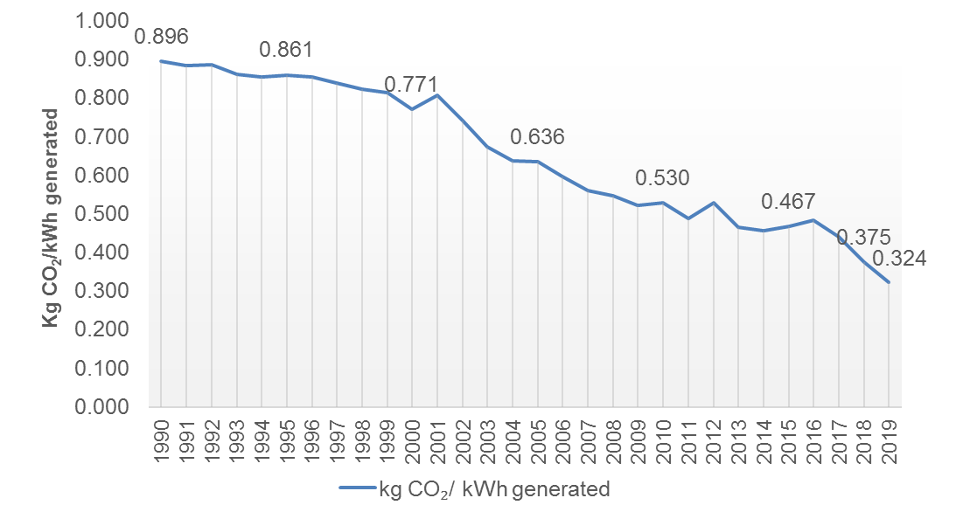
CO₂ Intensity of electricity generation

Slide 17
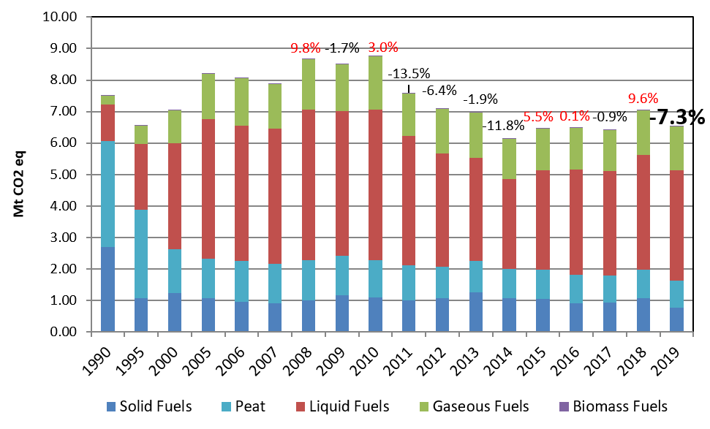
Residential

Slide 18
Residential emissions drivers

Slide 19
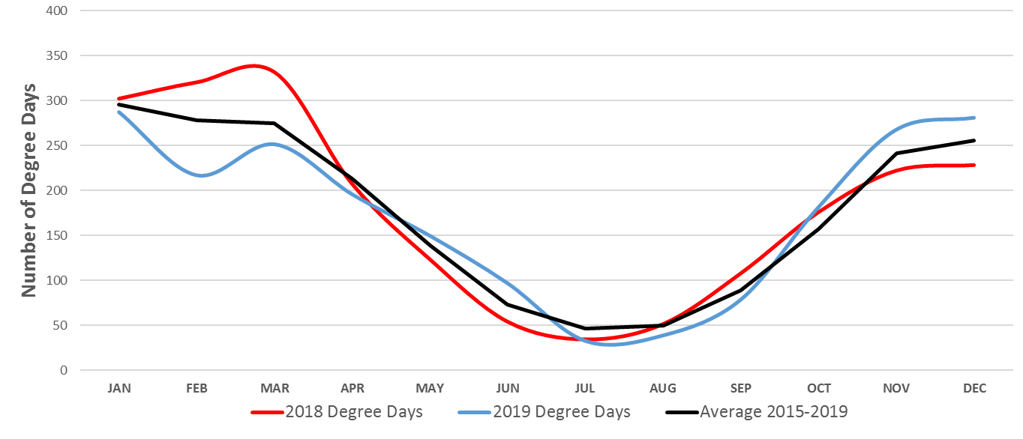
Weather and heating requirement
Source: Met Éireann

Slide 20
Remaining Sectors
Commercial and Public services sector emissions increased by 1.8% and 1.2% respectively, with increases of 2.1% in natural gas use in both sectors in 2019.
Emissions from the Manufacturing Combustion sector decreased by 2.0% or 0.10 Mt CO2eq in 2019.
Emissions from the Industrial Processes sector decreased by 1.5% (0.04 Mt CO2eq) in 2019 due to a reduction in cement production.
Emissions from the Waste sector decreased by 0.8% in 2019 or 0.01 Mt CO2eq.
F-Gas emissions were down 7.4% from 2018 to 2019, following a decrease of 13.8% in 2018. This is driven by a reduction in refrigeration and air conditioning emissions.

Slide 21
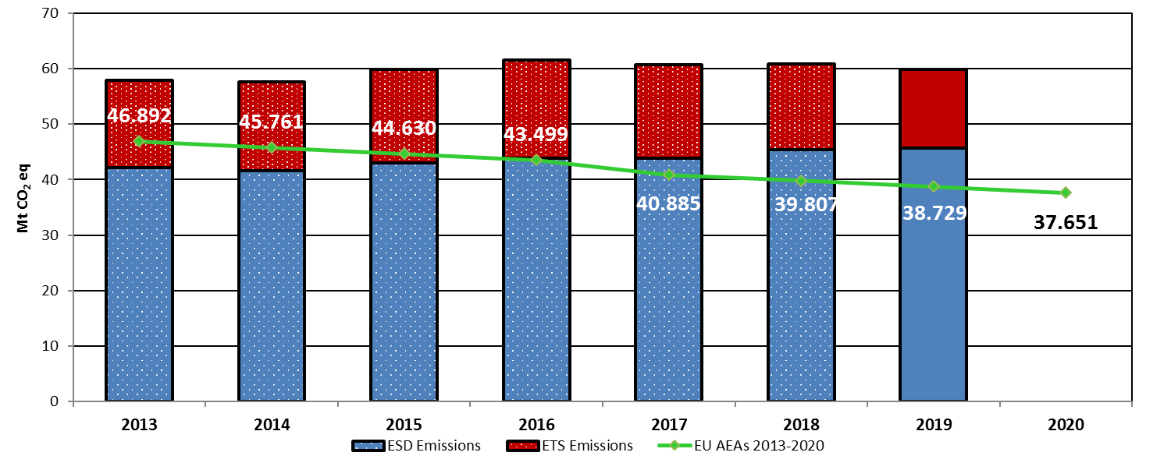
Compliance (Effort Sharing Decision)

Slide 22
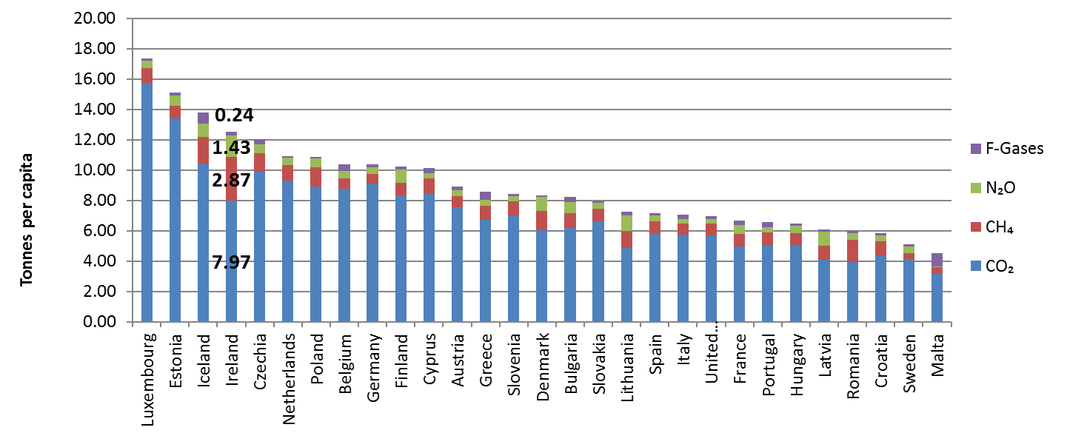
Emissions per capita (2018 comparison)

Slide 23
Conclusion
Despite the decrease, Ireland is still not on the pathway required to meet future targets and a climate neutral economy.
While 2020 is likely to see a reduction in emissions caused by the impact of the pandemic, this does not negate the need for long term and sustained action.
Focusing on climate action as part of a ‘green’ recovery offers the opportunity to respond to climate change while rebuilding our economy and generating new jobs.

Slide 24
