Slide 1
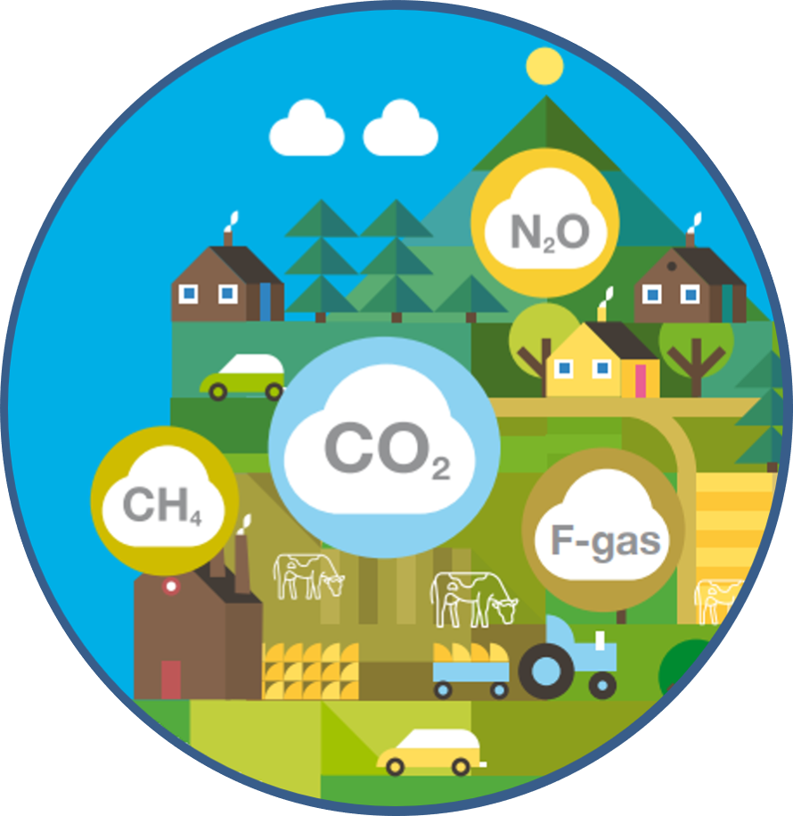
Greenhouse Gas Emissions: Agriculture Sector
Emissions Statistics team, EPA November 2020

Slide 2
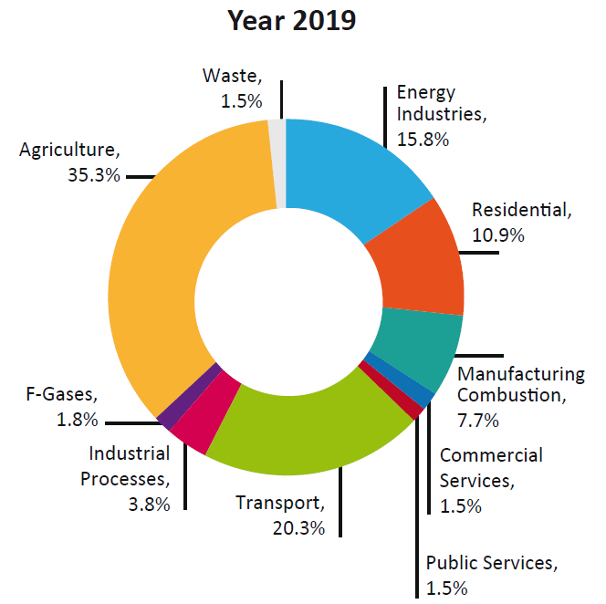
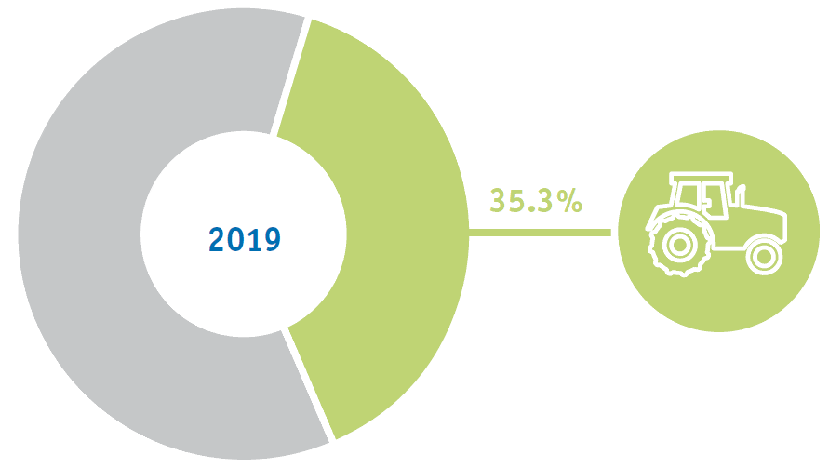
GHG Emissions by Sector: Agriculture

Slide 3
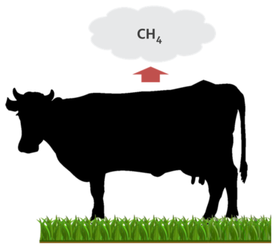
Livestock-related GHG Emissions
CH₄ Emissions from Enteric Fermentation
Ruminant livestock (e.g. cattle, sheep) are major sources of CH₄, while moderate amounts are produced from non-ruminant livestock (e.g. pigs, horses).
Amount produced dependent on
Type of digestion
Age
Weight
Quality and quantity of food

Slide 4
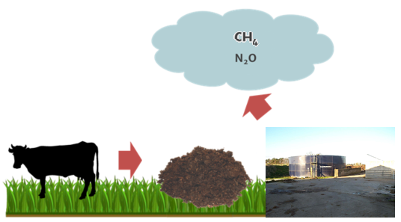
GHG Emissions from Manure
CH₄ emissions depend on:
Manure management system
Portion of manure decomposes anaerobically
Retention time
N₂O emissions depend on:
N content of manure
Duration of storage
Type of storage

Slide 5
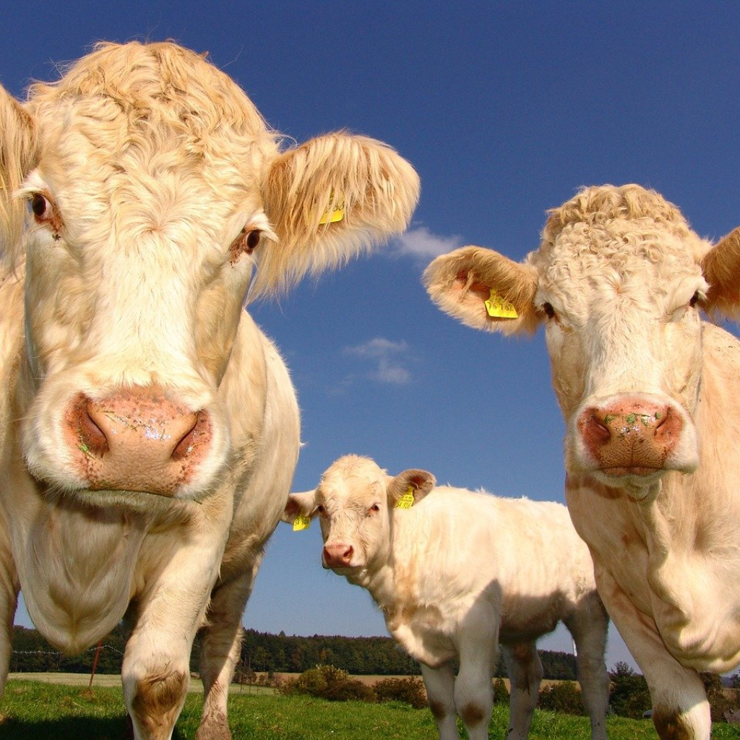
Updates to Agriculture Inventory: Why?
Previous estimates of CH₄ and N₂O did not accurately reflect the effects of current farming practices in Ireland.
To recognise and accurately quantify positive efforts made by farmers in the reduction of livestock emissions.

Slide 6
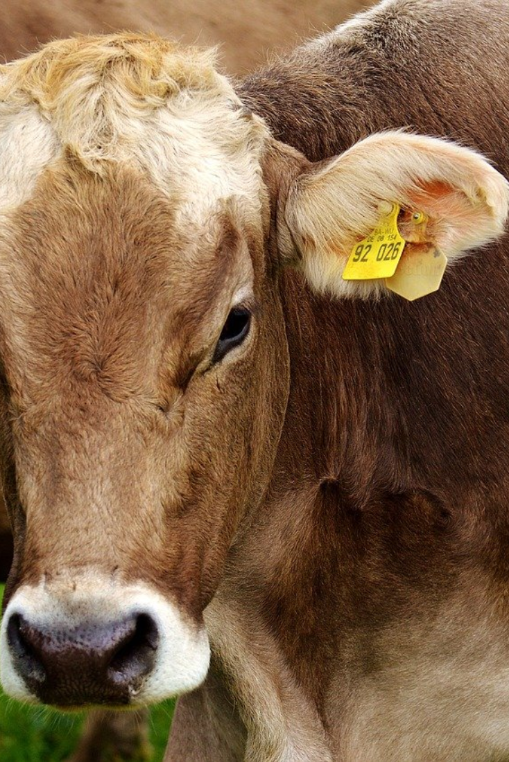
What We Updated
Updated CH₄ emissions models (originally developed in 2006, review published in 2019)
EPA-funded work undertaken by Teagasc Moorepark
Crude protein content of concentrate feeds and trends over time (previous source: 2003 survey)
Source: Dept. of Agriculture Food & Marine surveys (published 2020)
Updated data on current manure management practices and the use of low emission slurry spreading techniques (previous source: 2003 survey)
Source: Teagasc National Farm Survey (published 2020)

Slide 7

Trends in Concentrate Feed Usage

Slide 8

Trends in Livestock Housing

Slide 9
Trends in Manure Management

Slide 10
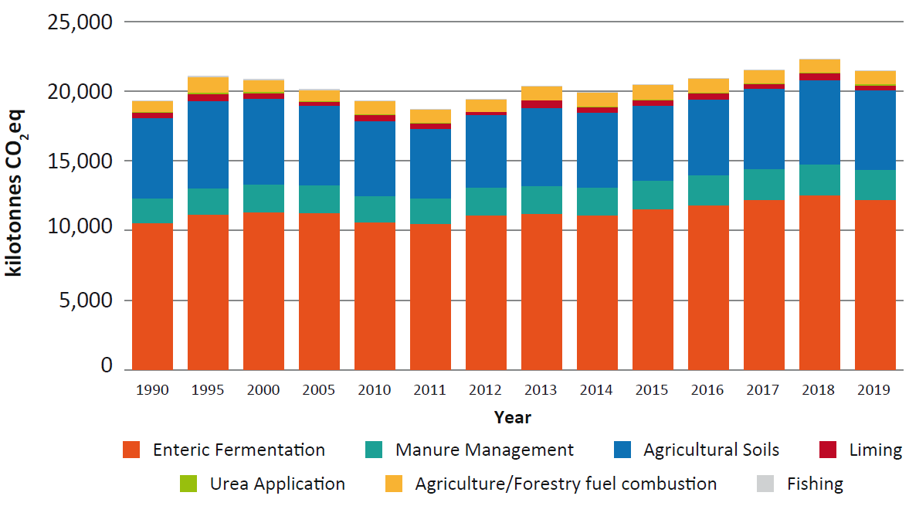
Agricultural Emissions 1990-2019

Slide 11
CH₄ and Nitrogen Excretion Rates per Cow

Slide 12
Trends in Milk Yield

Slide 13
CH₄ and Nitrogen Excretion Rates vs Milk Yield

Slide 14
Conclusions: A more accurate and robust inventory
Previous estimates of CH₄ and N₂O did not accurately reflect the effects of current farming practices in Ireland.
Updated methane models informed by the latest science from Teagasc
Parameterised with more up-to-date data on housing, diets, manure management and slurry spreading practices
To recognise and accurately quantify positive efforts made by farmers in the reduction of livestock emissions.
Now able to capture the benefits from mitigation measures (e.g. low emission slurry spreading, altered crude protein content in diets etc.)

Slide 15

Thank you for your attention

